Slide 1
CHAPTER 1
INTRODUCTION
Prem Mann, Introductory Statistics, 8/E Copyright © 2013 John Wiley & Sons. All rights reserved.

Slide 2
WHAT IS STATISTICS?
Definition
Statistics is the science of collecting, analyzing, presenting, and interpreting data, as well as of making decisions based on such analyses.
Prem Mann, Introductory Statistics, 8/E Copyright © 2013 John Wiley & Sons. All rights reserved.

Slide 3
TYPES OF STATISTICS
Definition
Descriptive Statistics consists of methods for organizing, displaying, and describing data by using tables, graphs, and summary measures.
Prem Mann, Introductory Statistics, 8/E Copyright © 2013 John Wiley & Sons. All rights reserved.

Slide 4
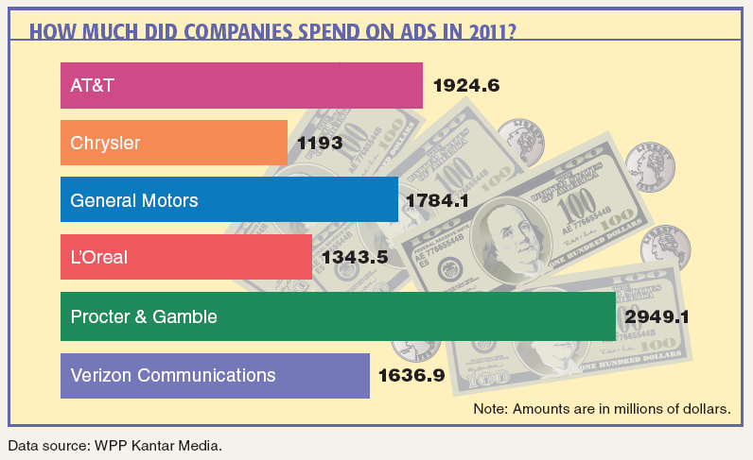
Case Study 1-1 How Much Did Companies Spend on Ads in 2011?
Prem Mann, Introductory Statistics, 8/E Copyright © 2013 John Wiley & Sons. All rights reserved.

Slide 5
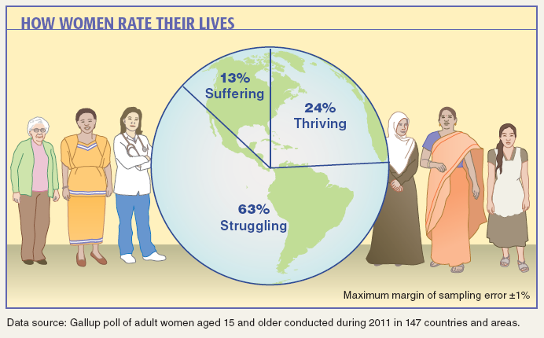
Case Study 1-2 How Women Rate Their Lives
Prem Mann, Introductory Statistics, 8/E Copyright © 2013 John Wiley & Sons. All rights reserved.

Slide 6
TYPES OF STATISTICS
Definition
Inferential Statistics consists of methods that use sample results to help make decisions or predictions about a population.
Prem Mann, Introductory Statistics, 8/E Copyright © 2013 John Wiley & Sons. All rights reserved.

Slide 7
POPULATION VERSUS SAMPLE
Definition
A population consists of all elements – individuals, items, or objects – whose characteristics are being studied. The population that is being studied is also called the target population.
A portion of the population selected for study is referred to as a sample.
Prem Mann, Introductory Statistics, 8/E Copyright © 2013 John Wiley & Sons. All rights reserved.

Slide 8
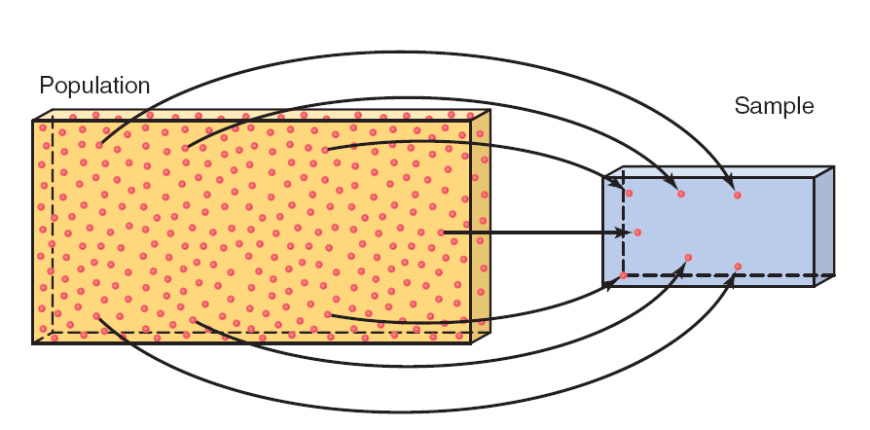
Figure 1.1 Population and Sample
Prem Mann, Introductory Statistics, 8/E Copyright © 2013 John Wiley & Sons. All rights reserved.

Slide 9
POPULATION VERSUS SAMPLE
Definition
A survey that includes every member of the population is called a census. The technique of collecting information from a portion of the population is called a sample survey.
Prem Mann, Introductory Statistics, 8/E Copyright © 2013 John Wiley & Sons. All rights reserved.

Slide 10
POPULATION VERSUS SAMPLE
Definition
A sample that represents the characteristics of the population as closely as possible is called a representative sample.
Prem Mann, Introductory Statistics, 8/E Copyright © 2013 John Wiley & Sons. All rights reserved.

Slide 11
BASIC TERMS
Definition
An element or member of a sample or population is a specific subject or object (for example, a person, firm, item, state, or country) about which the information is collected.
Prem Mann, Introductory Statistics, 8/E Copyright © 2013 John Wiley & Sons. All rights reserved.

Slide 12
BASIC TERMS
Definition
A variable is a characteristic under study that assumes different values for different elements.
The value of a variable for an element is called an observation or measurement.
A data set is a collection of observations on one or more variables.
Prem Mann, Introductory Statistics, 8/E Copyright © 2013 John Wiley & Sons. All rights reserved.

Slide 13
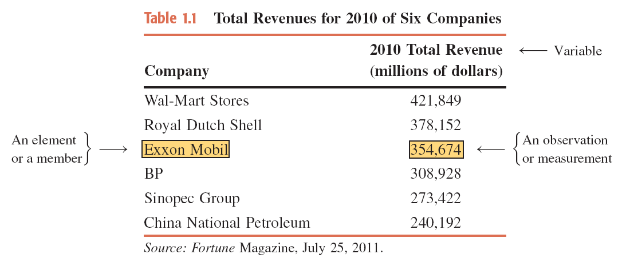
Table 1.1 Total Revenues for 2010 of Six Companies
Prem Mann, Introductory Statistics, 8/E Copyright © 2013 John Wiley & Sons. All rights reserved.

Slide 14
TYPES OF VARIABLES
Quantitative Variables
Discrete Variables
Continuous Variables
Qualitative or Categorical Variables
Prem Mann, Introductory Statistics, 8/E Copyright © 2013 John Wiley & Sons. All rights reserved.

Slide 15
Quantitative Variables
Definition
A variable that can be measured numerically is called a quantitative variable. The data collected on a quantitative variable are called quantitative data.
Prem Mann, Introductory Statistics, 8/E Copyright © 2013 John Wiley & Sons. All rights reserved.

Slide 16
Quantitative Variables: Discrete
Definition
A variable whose values are countable is called a discrete variable. In other words, a discrete variable can assume only certain values with no intermediate values.
Prem Mann, Introductory Statistics, 8/E Copyright © 2013 John Wiley & Sons. All rights reserved.

Slide 17
Quantitative Variables: Continuous
Definition
A variable that can assume any numerical value over a certain interval or intervals is called a continuous variable.
Prem Mann, Introductory Statistics, 8/E Copyright © 2013 John Wiley & Sons. All rights reserved.

Slide 18
Qualitative or Categorical Variables
Definition
A variable that cannot assume a numerical value but can be classified into two or more nonnumeric categories is called a qualitative or categorical variable. The data collected on such a variable are called qualitative data.
Prem Mann, Introductory Statistics, 8/E Copyright © 2013 John Wiley & Sons. All rights reserved.

Slide 19
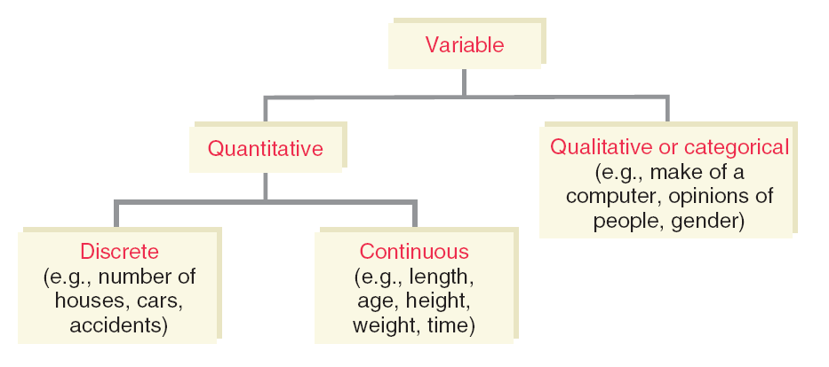
Figure 1.2 Types of Variables
Prem Mann, Introductory Statistics, 8/E Copyright © 2013 John Wiley & Sons. All rights reserved.

Slide 20
CROSS-SECTION VS. TIME-SERIES DATA
Cross-Section Data
Time-Series Data
Prem Mann, Introductory Statistics, 8/E Copyright © 2013 John Wiley & Sons. All rights reserved.

Slide 21
Cross-Section Data
Definition
Data collected on different elements at the same point in time or for the same period of time are called cross-section data.
Prem Mann, Introductory Statistics, 8/E Copyright © 2013 John Wiley & Sons. All rights reserved.

Slide 22
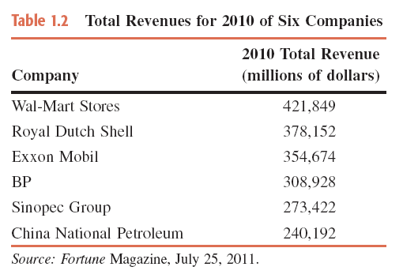
Table 1.2 Total Revenues for 2010 of Six Companies
Prem Mann, Introductory Statistics, 8/E Copyright © 2013 John Wiley & Sons. All rights reserved.

Slide 23
Time-Series Data
Definition
Data collected on the same element for the same variable at different points in time or for different periods of time are called time-series data.
Prem Mann, Introductory Statistics, 8/E Copyright © 2013 John Wiley & Sons. All rights reserved.

Slide 24
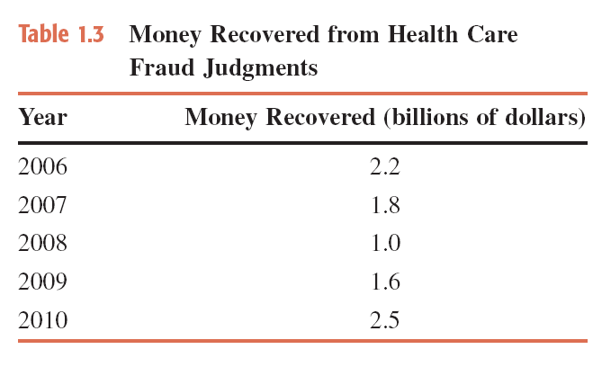
Table 1.3 Money Recovered from Health Care Fraud Judgments
Prem Mann, Introductory Statistics, 8/E Copyright © 2013 John Wiley & Sons. All rights reserved.

Slide 25
SOURCES OF DATA
Data may be obtained from
Internal Sources
External Sources
Surveys and Experiments
Prem Mann, Introductory Statistics, 8/E Copyright © 2013 John Wiley & Sons. All rights reserved.

Slide 26
SUMMATION NOTATION
Suppose a sample consists of five books, and the prices of these five books are
$175, $80, $165, $97, and $88
The variable price of a book: x
Price of the first book = x₁ = $175
Price of the second book = x₂ = $80
Price of the third book = x₃ = $165
Price of the fourth book = x₄ = $97
Price of the fifth book = x₅ = $88
Prem Mann, Introductory Statistics, 8/E Copyright © 2013 John Wiley & Sons. All rights reserved.

Slide 27
SUMMATION NOTATION
Adding the prices of all five books gives
x₁+x₂+x₃+x₄+x₅ = 175+80+165+97+88 = 605
Σx = x₁+x₂+x₃+x₄+x₅ = 605
Prem Mann, Introductory Statistics, 8/E Copyright © 2013 John Wiley & Sons. All rights reserved.

Slide 28
Example 1-1
Annual salaries (in thousands of dollars) of four workers are 75, 90, 125, and 61, respectively. Find
(a) ∑x (b) (∑x)² (c) ∑x²
Prem Mann, Introductory Statistics, 8/E Copyright © 2013 John Wiley & Sons. All rights reserved.

Slide 29
Example 1-1: Solution
(a) ∑x = x₁ + x₂ + x₃ + x₄
= 75 + 90 + 125 + 61
= 351 = $351,000
(b) Note that (∑x)² is the square of the sum of all x values.
Thus,
(∑x)² = (351)² = 123,201
Prem Mann, Introductory Statistics, 8/E Copyright © 2013 John Wiley & Sons. All rights reserved.

Slide 30
Example 1-1: Solution
(c) The expression ∑x² is the sum of the squares of x values.
To calculate ∑x² , we first square each of the x values and
then sum these squared values. Thus,
∑x² = (75)² + (90)² + (125)² + (61)²
= 5,625 + 8,100 + 15,625 + 3,721
= 33,071
Prem Mann, Introductory Statistics, 8/E Copyright © 2013 John Wiley & Sons. All rights reserved.

Slide 31
Example 1-2
The following table lists four pairs of m and f values:
Compute the following:
(a) Σm (b) Σf² (c) Σmf (d) Σm²f
Prem Mann, Introductory Statistics, 8/E Copyright © 2013 John Wiley & Sons. All rights reserved.

Slide 32
Example 1-2: Solution
We can write
m₁ = 12 m₂ = 15 m₃ = 20 m₄ = 30
f₁ = 5 f₂ = 9 f₃ = 10 f₄ = 16
(a) (b) (c) (d)
Prem Mann, Introductory Statistics, 8/E Copyright © 2013 John Wiley & Sons. All rights reserved.

