Slide 1
CHAPTER 2 (PART A)
Organizing and Graphing Qualitative & Quantitative Data
Prem Mann, Introductory Statistics, 8/E Copyright © 2013 John Wiley & Sons. All rights reserved.

Slide 2
RAW DATA
Definition
Data recorded in the sequence in which they are collected and before they are processed or ranked are called raw data.
Prem Mann, Introductory Statistics, 8/E Copyright © 2013 John Wiley & Sons. All rights reserved.

Slide 3
Table 2.1 Ages of 50 Students
Prem Mann, Introductory Statistics, 8/E Copyright © 2013 John Wiley & Sons. All rights reserved.

Slide 4
Table 2.2 Status of 50 Students
Prem Mann, Introductory Statistics, 8/E Copyright © 2013 John Wiley & Sons. All rights reserved.

Slide 5
ORGANIZING AND GRAPHING DATA
Frequency Distributions
Relative Frequency and Percentage Distributions
Graphical Presentation of Qualitative Data
Prem Mann, Introductory Statistics, 8/E Copyright © 2013 John Wiley & Sons. All rights reserved.

Slide 6
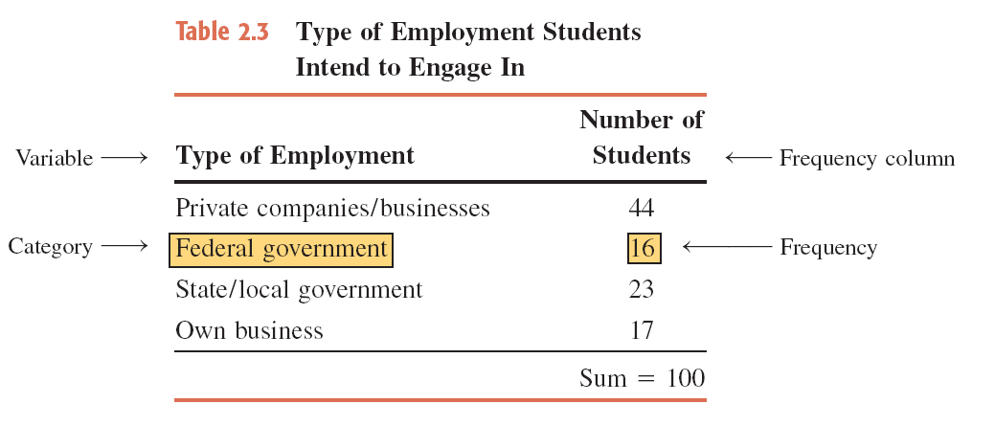
Table 2.3 Types of Employment Students Intend to Engage In
Prem Mann, Introductory Statistics, 8/E Copyright © 2013 John Wiley & Sons. All rights reserved.

Slide 7
Frequency Distributions
Definition
A frequency distribution of a qualitative variable lists all categories and the number of elements that belong to each of the categories.
Prem Mann, Introductory Statistics, 8/E Copyright © 2013 John Wiley & Sons. All rights reserved.

Slide 8
Example 2-1
A sample of 30 persons who often consume donuts were asked what variety of donuts was their favorite. The responses from these 30 persons were as follows:
Prem Mann, Introductory Statistics, 8/E Copyright © 2013 John Wiley & Sons. All rights reserved.

Slide 9
Example 2-1
glazed | filled | other | plain | glazed | other
frosted | filled | filled | glazed | other | frosted
glazed | plain | other | glazed | glazed | filled
frosted | plain | other | other | frosted | filled
filled | other | frosted | glazed | glazed | filled
Construct a frequency distribution table for these data.
Prem Mann, Introductory Statistics, 8/E Copyright © 2013 John Wiley & Sons. All rights reserved.

Slide 10
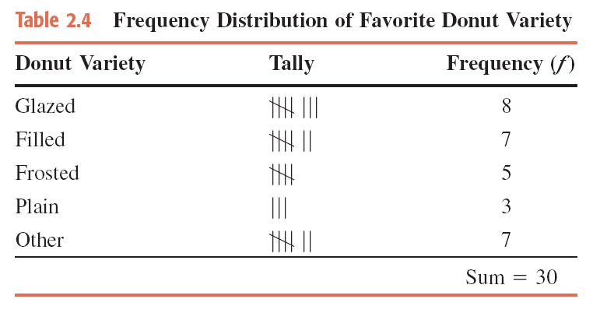
Example 2-1: Solution Table 2.4 Frequency Distribution of Favorite Donut Variety
Prem Mann, Introductory Statistics, 8/E Copyright © 2013 John Wiley & Sons. All rights reserved.

Slide 11
Relative Frequency and Percentage Distributions
Calculating Relative Frequency of a Category
Prem Mann, Introductory Statistics, 8/E Copyright © 2013 John Wiley & Sons. All rights reserved.

Slide 12
Relative Frequency and Percentage Distributions
Calculating Percentage
Percentage = (Relative frequency) · 100%
Prem Mann, Introductory Statistics, 8/E Copyright © 2013 John Wiley & Sons. All rights reserved.

Slide 13
Example 2-2
Determine the relative frequency and percentage for the data in Table 2.4.
Prem Mann, Introductory Statistics, 8/E Copyright © 2013 John Wiley & Sons. All rights reserved.

Slide 14
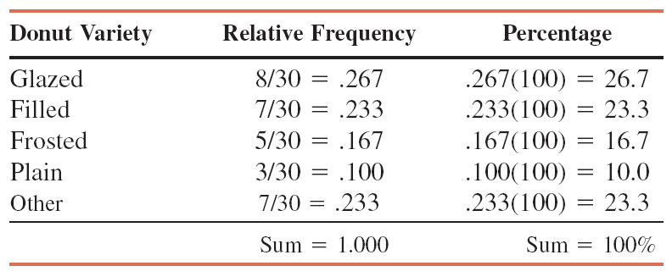
Example 2-2: Solution Table 2.5 Relative Frequency and Percentage Distributions of Favorite Donut Variety
Prem Mann, Introductory Statistics, 8/E Copyright © 2013 John Wiley & Sons. All rights reserved.

Slide 15
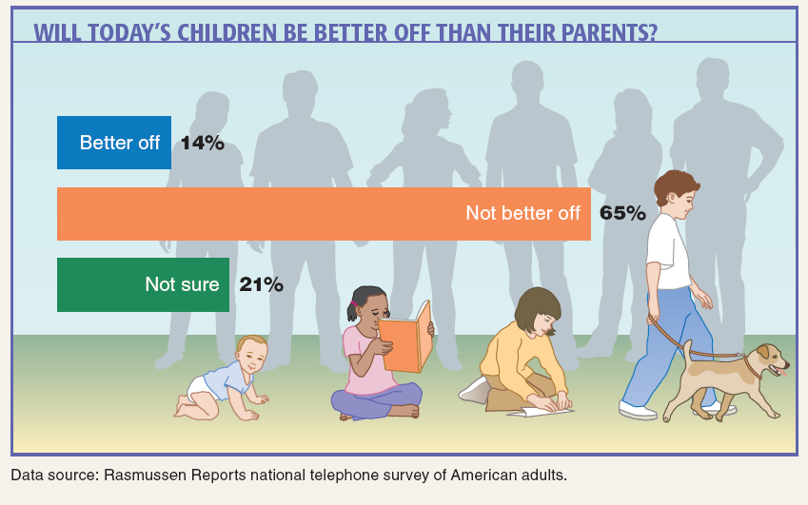
Case Study 2-1 Will Today’s Children Be Better Off Than Their Parents?
Prem Mann, Introductory Statistics, 8/E Copyright © 2013 John Wiley & Sons. All rights reserved.

Slide 16
Graphical Presentation of Qualitative Data
Definition
A graph made of bars whose heights represent the frequencies of respective categories is called a bar graph.
Prem Mann, Introductory Statistics, 8/E Copyright © 2013 John Wiley & Sons. All rights reserved.

Slide 17
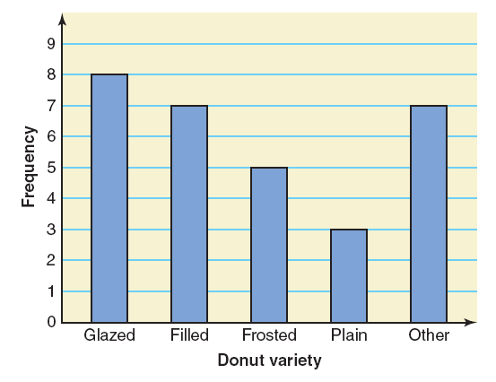
Figure 2.1 Bar graph for the frequency distribution of Table 2.4
Prem Mann, Introductory Statistics, 8/E Copyright © 2013 John Wiley & Sons. All rights reserved.

Slide 18
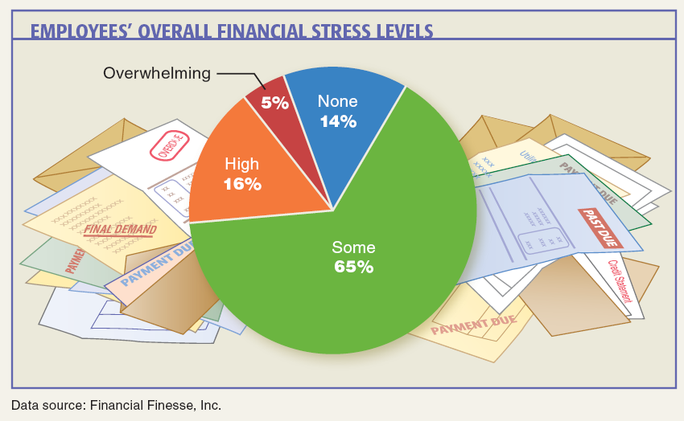
Case Study 2-2 Employees’ Overall Financial Stress Levels
Prem Mann, Introductory Statistics, 8/E Copyright © 2013 John Wiley & Sons. All rights reserved.

Slide 19
Graphical Presentation of Qualitative Data
Definition
A circle divided into portions that represent the relative frequencies or percentages of a population or a sample belonging to different categories is called a pie chart.
Prem Mann, Introductory Statistics, 8/E Copyright © 2013 John Wiley & Sons. All rights reserved.

Slide 20
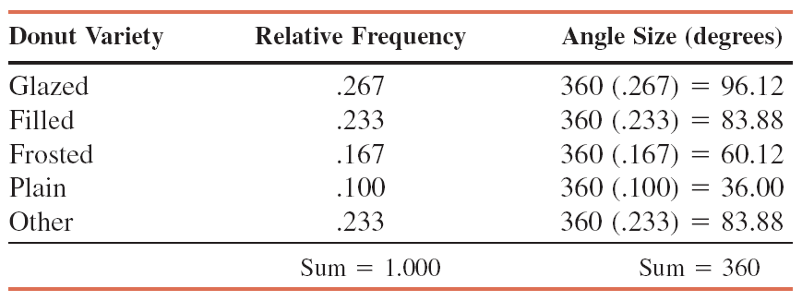
Table 2.6 Calculating Angle Sizes for the Pie Chart
Prem Mann, Introductory Statistics, 8/E Copyright © 2013 John Wiley & Sons. All rights reserved.

Slide 21
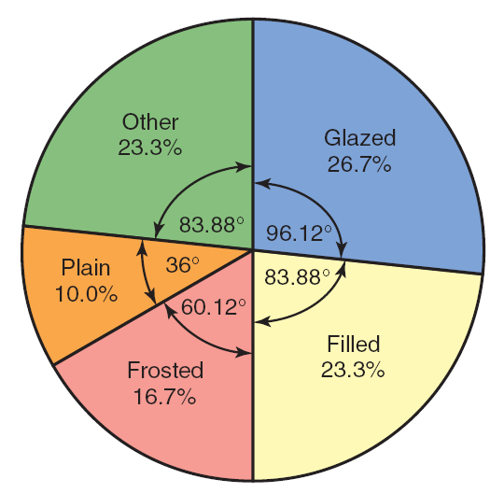
Figure 2.2 Pie chart for the percentage distribution of Table 2.5.
Prem Mann, Introductory Statistics, 8/E Copyright © 2013 John Wiley & Sons. All rights reserved.

Slide 22
ORGANIZING AND GRAPHING QUANTITATIVE
Frequency Distributions
Constructing Frequency Distribution Tables
Relative and Percentage Distributions
Graphing Grouped Data
Prem Mann, Introductory Statistics, 8/E Copyright © 2013 John Wiley & Sons. All rights reserved.

Slide 23
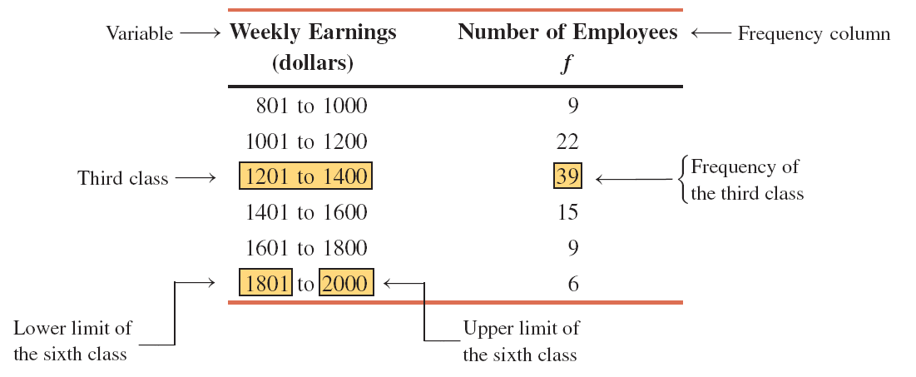
Table 2.7 Weekly Earnings of 100 Employees of a Company
Prem Mann, Introductory Statistics, 8/E Copyright © 2013 John Wiley & Sons. All rights reserved.

Slide 24
Frequency Distributions
Definition
A frequency distribution for quantitative data lists all the classes and the number of values that belong to each class. Data presented in the form of a frequency distribution are called grouped data.
Prem Mann, Introductory Statistics, 8/E Copyright © 2013 John Wiley & Sons. All rights reserved.

Slide 25
Frequency Distributions
Definition
The class boundary is given by the midpoint of the upper limit of one class and the lower limit of the next class.
Prem Mann, Introductory Statistics, 8/E Copyright © 2013 John Wiley & Sons. All rights reserved.

Slide 26
Frequency Distributions
Finding Class Width
Class width = Upper boundary – Lower boundary
Prem Mann, Introductory Statistics, 8/E Copyright © 2013 John Wiley & Sons. All rights reserved.

Slide 27
Frequency Distributions
Calculating Class Midpoint or Mark
Prem Mann, Introductory Statistics, 8/E Copyright © 2013 John Wiley & Sons. All rights reserved.

Slide 28
Constructing Frequency Distribution Tables
Calculation of Class Width
Prem Mann, Introductory Statistics, 8/E Copyright © 2013 John Wiley & Sons. All rights reserved.

Slide 29
Table 2.8 Class Boundaries, Class Widths, and Class Midpoints for Table 2.7
Prem Mann, Introductory Statistics, 8/E Copyright © 2013 John Wiley & Sons. All rights reserved.

Slide 30
Example 2-3
The following data give the total number of iPods® sold by a mail order company on each of 30 days. Construct a frequency distribution table.
8 | 25 | 11 | 15 | 29 | 22 | 10 | 5 | 17 | 21
22 | 13 | 26 | 16 | 18 | 12 | 9 | 26 | 20 | 16
23 | 14 | 19 | 23 | 20 | 16 | 27 | 16 | 21 | 14
Prem Mann, Introductory Statistics, 8/E Copyright © 2013 John Wiley & Sons. All rights reserved.

Slide 31
Example 2-3: Solution
The minimum value is 5, and the maximum value is 29. Suppose we decide to group these data using five classes of equal width. Then,
Now we round this approximate width to a convenient number, say 5. The lower limit of the first class can be taken as 5 or any number less than 5. Suppose we take 5 as the lower limit of the first class. Then our classes will be
5 – 9, 10 – 14, 15 – 19, 20 – 24, and 25 – 29
Prem Mann, Introductory Statistics, 8/E Copyright © 2013 John Wiley & Sons. All rights reserved.

Slide 32
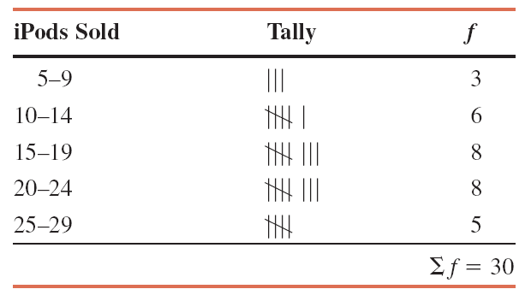
Table 2.9 Frequency Distribution for the Data on iPods Sold
Prem Mann, Introductory Statistics, 8/E Copyright © 2013 John Wiley & Sons. All rights reserved.

Slide 33
Relative Frequency and Percentage Distributions
Calculating Relative Frequency and Percentage
Prem Mann, Introductory Statistics, 8/E Copyright © 2013 John Wiley & Sons. All rights reserved.

Slide 34
Example 2-4
Calculate the relative frequencies and percentages for Table 2.9.
Prem Mann, Introductory Statistics, 8/E Copyright © 2013 John Wiley & Sons. All rights reserved.

Slide 35
Example 2-4: Solution Table 2.10 Relative Frequency and Percentage Distributions for Table 2.9
Prem Mann, Introductory Statistics, 8/E Copyright © 2013 John Wiley & Sons. All rights reserved.

Slide 36
Graphing Grouped Data
Definition
A histogram is a graph in which classes are marked on the horizontal axis and the frequencies, relative frequencies, or percentages are marked on the vertical axis. The frequencies, relative frequencies, or percentages are represented by the heights of the bars. In a histogram, the bars are drawn adjacent to each other.
Prem Mann, Introductory Statistics, 8/E Copyright © 2013 John Wiley & Sons. All rights reserved.

Slide 37
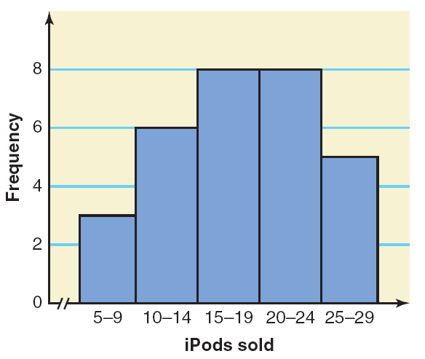
Figure 2.3 Frequency histogram for Table 2.9.
Prem Mann, Introductory Statistics, 8/E Copyright © 2013 John Wiley & Sons. All rights reserved.

Slide 38
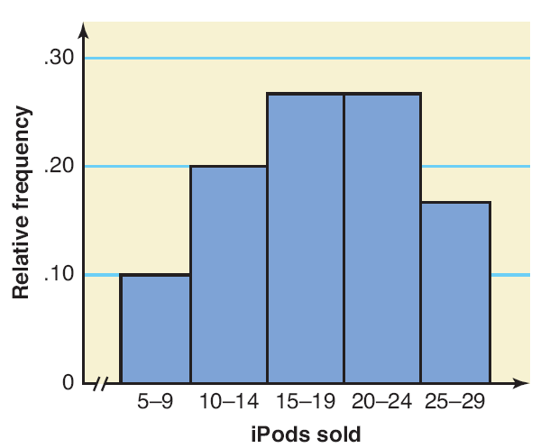
Figure 2.4 Relative frequency histogram for Table 2.10.
Prem Mann, Introductory Statistics, 8/E Copyright © 2013 John Wiley & Sons. All rights reserved.

Slide 39
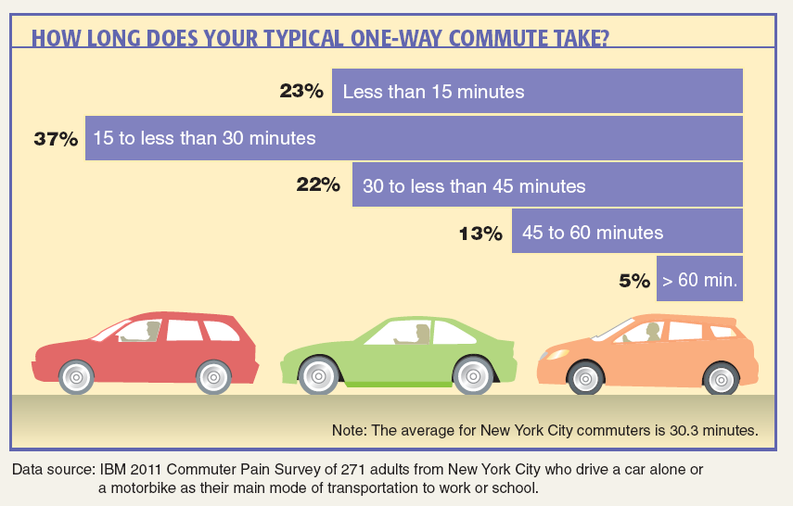
Case Study 2-3 How Long Does Your Typical One-Way Commute Take?
Prem Mann, Introductory Statistics, 8/E Copyright © 2013 John Wiley & Sons. All rights reserved.

Slide 40
Graphing Grouped Data
Definition
A graph formed by joining the midpoints of the tops of successive bars in a histogram with straight lines is called a polygon.
Prem Mann, Introductory Statistics, 8/E Copyright © 2013 John Wiley & Sons. All rights reserved.

Slide 41
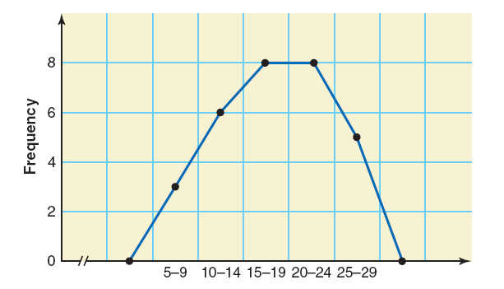
Figure 2.5 Frequency polygon for Table 2.9.
Prem Mann, Introductory Statistics, 8/E Copyright © 2013 John Wiley & Sons. All rights reserved.

Slide 42
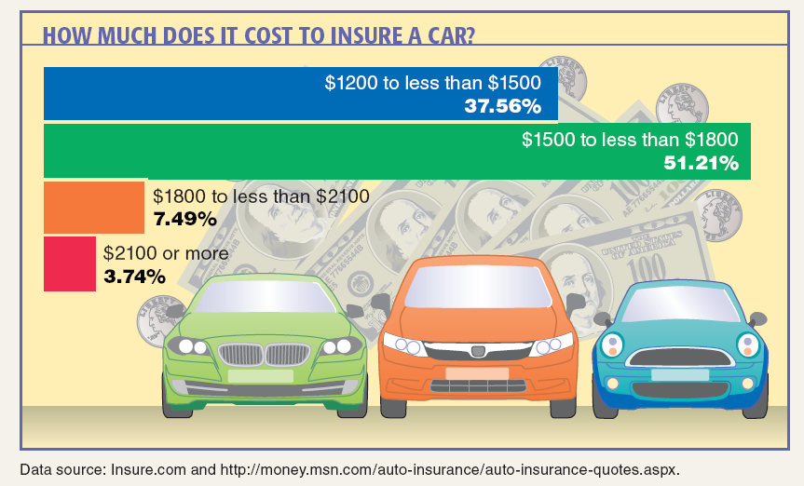
Case Study 2-4 How Much Does it Cost to Insure a Car?
Prem Mann, Introductory Statistics, 8/E Copyright © 2013 John Wiley & Sons. All rights reserved.

Slide 43
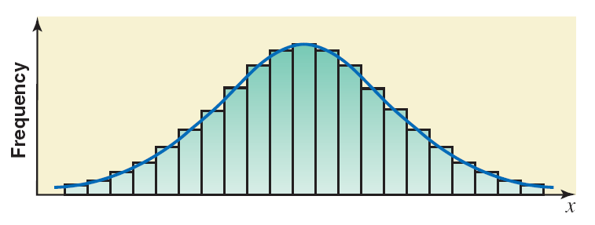
Figure 2.6 Frequency distribution curve.
Prem Mann, Introductory Statistics, 8/E Copyright © 2013 John Wiley & Sons. All rights reserved.

Slide 44
Example 2-5
The percentage of the population working in the United States peaked in 2000 but dropped to the lowest level in 30 years in 2010. Table 2.11 shows the percentage of the population working in each of the 50 states in 2010. These percentages exclude military personnel and self-employed persons. (Source: USA TODAY, April 14, 2011. Based on data from the U.S. Census Bureau and U.S. Bureau of Labor Statistics.)
Prem Mann, Introductory Statistics, 8/E Copyright © 2013 John Wiley & Sons. All rights reserved.

Slide 45
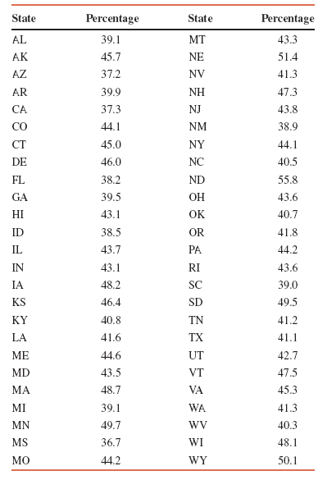
Example 2-5
Construct a frequency distribution table. Calculate the relative frequencies and percentages for all classes.
Prem Mann, Introductory Statistics, 8/E Copyright © 2013 John Wiley & Sons. All rights reserved.

Slide 46
Example 2-5: Solution
The minimum value in the data set of Table 2.11 is 36.7%, and the maximum value is 55.8%. Suppose we decide to group these data using six classes of equal width. Then,
$$Approximate width of a class= \frac{55.8 −36.7}{6}=3.18$$
We round this to a more convenient number, say 3. We can take a lower limit of the first class equal to 36.7 or any number lower than 36.7. If we start the first class at 36, the classes will be written as 36 to less than 39, 39 to less than 42, and so on.
Prem Mann, Introductory Statistics, 8/E Copyright © 2013 John Wiley & Sons. All rights reserved.

Slide 47
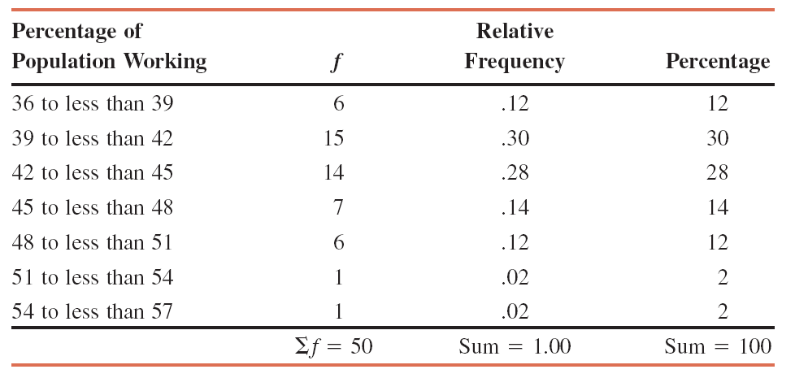
Table 2.12 Frequency, Relative Frequency, and Percentage Distributions of the Percentage of Population Workings
Prem Mann, Introductory Statistics, 8/E Copyright © 2013 John Wiley & Sons. All rights reserved.

Slide 48
Example 2-6
The administration in a large city wanted to know the distribution of vehicles owned by households in that city. A sample of 40 randomly selected households from this city produced the following data on the number of vehicles owned:
5 1 1 2 0 1 1 2 1 1
1 3 3 0 2 5 1 2 3 4
2 1 2 2 1 2 2 1 1 1
4 2 1 1 2 1 1 4 1 3
Construct a frequency distribution table for these data using single-valued classes.
Prem Mann, Introductory Statistics, 8/E Copyright © 2013 John Wiley & Sons. All rights reserved.

Slide 49
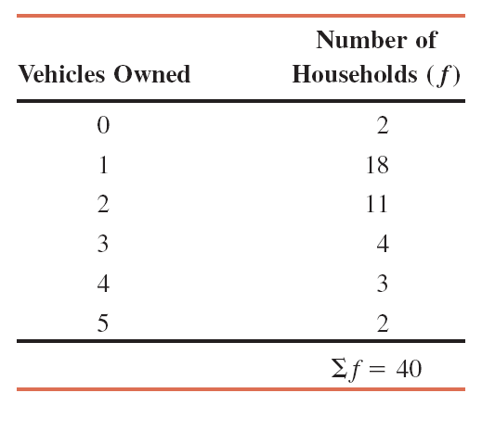
Example 2-6: Solution Table 2.13 Frequency Distribution of Vehicles Owned
The observations assume only six distinct values: 0, 1, 2, 3, 4, and 5. Each of these six values is used as a class in the frequency distribution in Table 2.13.
Prem Mann, Introductory Statistics, 8/E Copyright © 2013 John Wiley & Sons. All rights reserved.

Slide 50
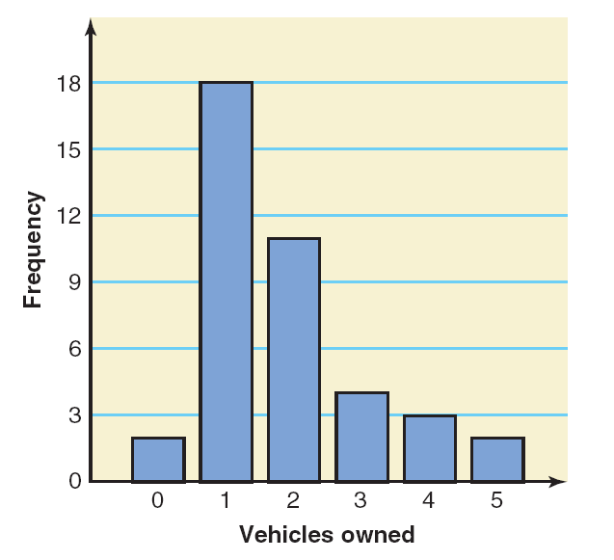
Figure 2.7 Bar graph for Table 2.13.
Prem Mann, Introductory Statistics, 8/E Copyright © 2013 John Wiley & Sons. All rights reserved.

Slide 51
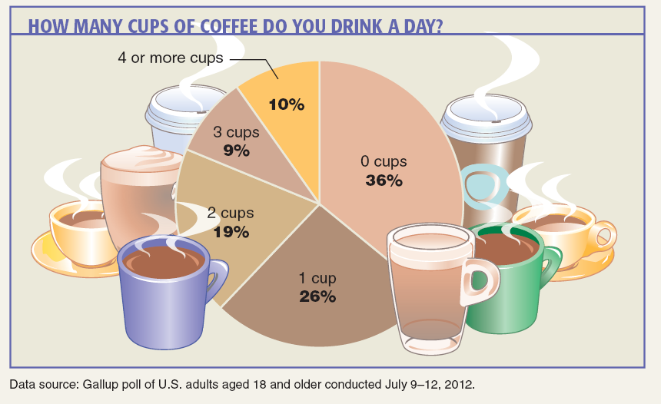
Case Study 2-5 How Many Cups of Coffee Do You Drink a Day?
Prem Mann, Introductory Statistics, 8/E Copyright © 2013 John Wiley & Sons. All rights reserved.

Slide 52
SHAPES OF HISTOGRAMS
Symmetric
Skewed
Uniform or Rectangular
Prem Mann, Introductory Statistics, 8/E Copyright © 2013 John Wiley & Sons. All rights reserved.

Slide 53
Figure 2.8 Symmetric histograms.
Prem Mann, Introductory Statistics, 8/E Copyright © 2013 John Wiley & Sons. All rights reserved.

Slide 54
Figure 2.9 (a) A histogram skewed to the right. (b) A histogram skewed to the left.
Prem Mann, Introductory Statistics, 8/E Copyright © 2013 John Wiley & Sons. All rights reserved.

Slide 55
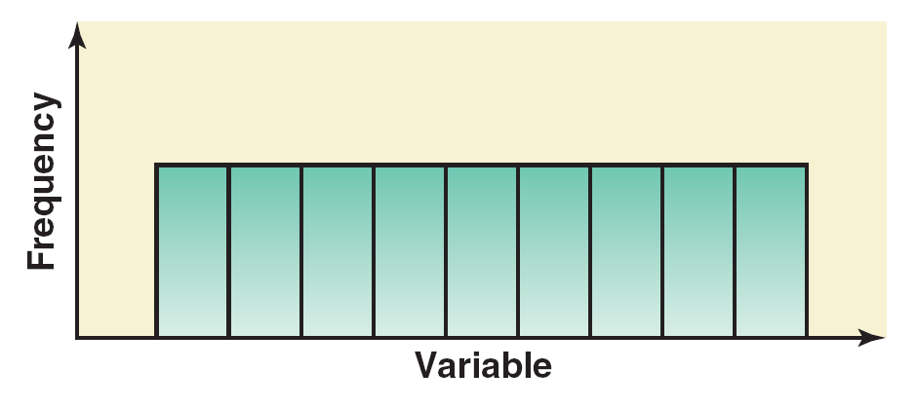
Figure 2.10 A histogram with uniform distribution.
Prem Mann, Introductory Statistics, 8/E Copyright © 2013 John Wiley & Sons. All rights reserved.

Slide 56
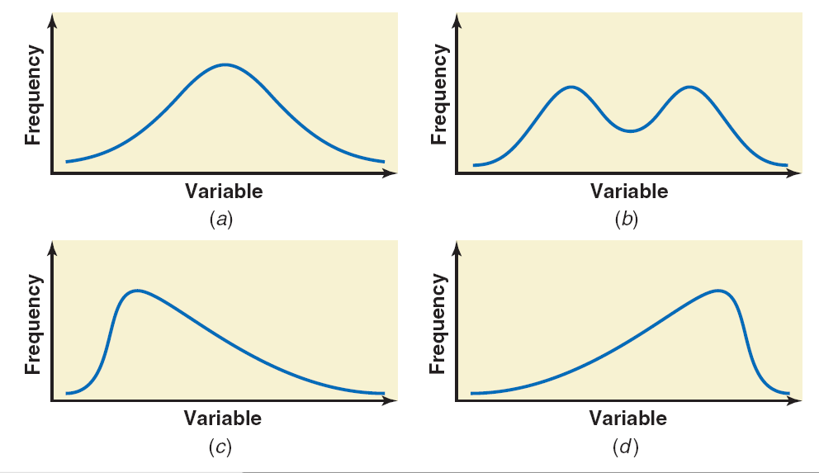
Figure 2.11 (a) and (b) Symmetric frequency curves. (c) Frequency curve skewed to the right. (d) Frequency curve skewed to the left.
Prem Mann, Introductory Statistics, 8/E Copyright © 2013 John Wiley & Sons. All rights reserved.

