Slide 1
CHAPTER 3
NUMERICAL DESCRIPTIVE MEASURES (Part A)
Prem Mann, Introductory Statistics, 8/E Copyright © 2013 John Wiley & Sons. All rights reserved.

Slide 2
MEASURES OF CENTRAL TENDENCY FOR UNGROUPED DATA
Mean
Median
Mode
Relationships among the Mean, Median, and Mode
Prem Mann, Introductory Statistics, 8/E Copyright © 2013 John Wiley & Sons. All rights reserved.

Slide 3
Mean
The mean for ungrouped data is obtained by dividing the
sum of all values by the number of values in the data set. Thus,
Mean for population data:
Mean for sample data:
where is the sum of all values; N is the population size; n
is the sample size; is the population mean; and is the
sample mean.
Prem Mann, Introductory Statistics, 8/E Copyright © 2013 John Wiley & Sons. All rights reserved.

Slide 4
Example 3-1
Table 3.1 lists the total cash donations (rounded to millions of
dollars) given by eight U.S. companies during the year 2010
(Source: Based on U.S. Internal Revenue Service data
analyzed by The Chronicle of Philanthropy and USA TODAY).
Prem Mann, Introductory Statistics, 8/E Copyright © 2013 John Wiley & Sons. All rights reserved.

Slide 5
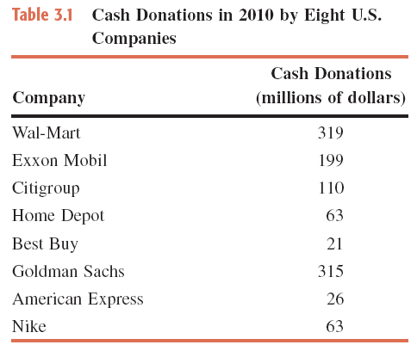
Table 3.1 Cash Donations in 2010 by Eight U.S. Companies
Find the mean of cash donations made by these eight companies.
Prem Mann, Introductory Statistics, 8/E Copyright © 2013 John Wiley & Sons. All rights reserved.

Slide 6
Example 3-1: Solution
Thus, these eight companies donated an average of $139.5 million in 2010 for charitable purposes.
Prem Mann, Introductory Statistics, 8/E Copyright © 2013 John Wiley & Sons. All rights reserved.

Slide 7
Example 3-2
The following are the ages (in years) of all eight employees of a
small company:
53 32 61 27 39 44 49 57
Find the mean age of these employees.
Prem Mann, Introductory Statistics, 8/E Copyright © 2013 John Wiley & Sons. All rights reserved.

Slide 8
Example 3-2: Solution
The population mean is
Thus, the mean age of all eight employees of this company is 45.25 years, or 45 years and 3 months.
Prem Mann, Introductory Statistics, 8/E Copyright © 2013 John Wiley & Sons. All rights reserved.

Slide 9
Median
Definition
The median is the value of the middle term in a data set that has been ranked in increasing order.
The calculation of the median consists of the following two steps:
Rank the data set in increasing order.
Find the middle term. The value of this term is the median.
Prem Mann, Introductory Statistics, 8/E Copyright © 2013 John Wiley & Sons. All rights reserved.

Slide 10
Example 3-3
Refer to the data on the number of homes foreclosed in seven
states given in Table 3.2 of Example 3.3. Those values are
listed below.
173,175 49,723 20,352 10,824 40,911 18,038 61,848
Find the median for these data.
Prem Mann, Introductory Statistics, 8/E Copyright © 2013 John Wiley & Sons. All rights reserved.

Slide 11
Example 3-3: Solution
First, we rank the given data in increasing order as follows:
10,824 18,038 20,352 40,911 49,723 61,848 173,175
Since there are seven homes in this data set and the middle
term is the fourth term,
Thus, the median number of homes foreclosed in these seven
states was 40,911 in 2010.
Prem Mann, Introductory Statistics, 8/E Copyright © 2013 John Wiley & Sons. All rights reserved.

Slide 12
Example 3-4
Table 3.3 gives the total compensations (in millions of dollars) for the year 2010 of the 12 highest-paid CEOs of U.S. companies.
Prem Mann, Introductory Statistics, 8/E Copyright © 2013 John Wiley & Sons. All rights reserved.

Slide 13
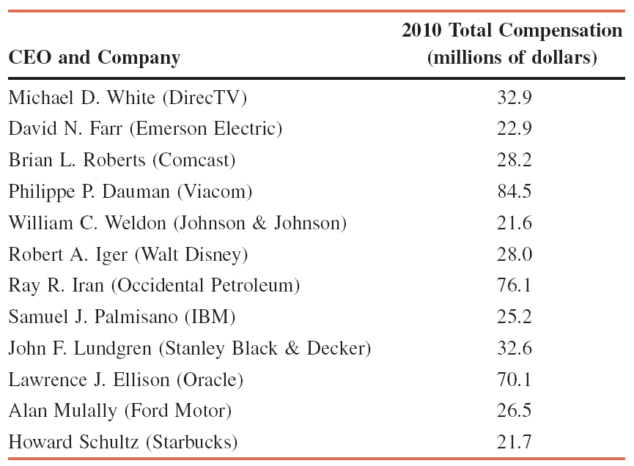
Table 3.4 Total Compensations of 12 Highest-Paid CEOs for the Year 2010
Find the median for these data.
Prem Mann, Introductory Statistics, 8/E Copyright © 2013 John Wiley & Sons. All rights reserved.

Slide 14
Example 3-4: Solution
First we rank the given total compensations of the 12 CESs as follows:
21.6 21.7 22.9 25.2 26.5 28.0 28.2 32.6 32.9 70.1 76.1 84.5
There are 12 values in this data set. Because there are an even number of values in the data set, the median is given by the average of the two middle values.
Prem Mann, Introductory Statistics, 8/E Copyright © 2013 John Wiley & Sons. All rights reserved.

Slide 15
Example 3-4: Solution
The two middle values are the sixth and seventh in the arranged data, and these two values are 28.0 and 28.2.
Thus, the median for the 2010 compensations of these 12 CEOs is $28.1 million.
Prem Mann, Introductory Statistics, 8/E Copyright © 2013 John Wiley & Sons. All rights reserved.

Slide 16
Mode
Definition
The mode is the value that occurs with the highest frequency in a data set.
Prem Mann, Introductory Statistics, 8/E Copyright © 2013 John Wiley & Sons. All rights reserved.

Slide 17
Example 3-5
The following data give the speeds (in miles per hour) of eight cars that were stopped on I-95 for speeding violations.
77 82 74 81 79 84 74 78
Find the mode.
Prem Mann, Introductory Statistics, 8/E Copyright © 2013 John Wiley & Sons. All rights reserved.

Slide 18
Example 3-5: Solution
In this data set, 74 occurs twice and each of the remaining values occurs only once. Because 74 occurs with the highest frequency, it is the mode. Therefore,
Mode = 74 miles per hour
Prem Mann, Introductory Statistics, 8/E Copyright © 2013 John Wiley & Sons. All rights reserved.

Slide 19
Mode
A major shortcoming of the mode is that a data set may have none or may have more than one mode, whereas it will have only one mean and only one median.
Unimodal: A data set with only one mode.
Bimodal: A data set with two modes.
Multimodal: A data set with more than two modes.
Prem Mann, Introductory Statistics, 8/E Copyright © 2013 John Wiley & Sons. All rights reserved.

Slide 20
Example 3-6 (Data set with no mode)
Last year’s incomes of five randomly selected families were $76,150, $95,750, $124,985, $87,490, and $53,740.
Find the mode.
Prem Mann, Introductory Statistics, 8/E Copyright © 2013 John Wiley & Sons. All rights reserved.

Slide 21
Example 3-6: Solution
Because each value in this data set occurs only once, this data set contains no mode.
Prem Mann, Introductory Statistics, 8/E Copyright © 2013 John Wiley & Sons. All rights reserved.

Slide 22
Example 3-7 (Data set with two modes)
A small company has 12 employees. Their commuting times
(rounded to the nearest minute) from home to work are 23,
36, 12, 23, 47, 32, 8, 12, 26, 31, 18, and 28, respectively.
Find the mode for these data.
Prem Mann, Introductory Statistics, 8/E Copyright © 2013 John Wiley & Sons. All rights reserved.

Slide 23
Example 3-7: Solution
In the given data on the commuting times of the 12
employees, each of the values 12 and 23 occurs twice, and
each of the remaining values occurs only once. Therefore, that
data set has two modes: 12 and 23 minutes.
Prem Mann, Introductory Statistics, 8/E Copyright © 2013 John Wiley & Sons. All rights reserved.

Slide 24
Example 3-8 (Data set with three modes)
The ages of 10 randomly selected students from a class are 21,
19, 27, 22, 29, 19, 25, 21, 22 and 30 years, respectively.
Find the mode.
Prem Mann, Introductory Statistics, 8/E Copyright © 2013 John Wiley & Sons. All rights reserved.

Slide 25
Example 3-8: Solution
This data set has three modes: 19, 21 and 22. Each of these
three values occurs with a (highest) frequency of 2.
Prem Mann, Introductory Statistics, 8/E Copyright © 2013 John Wiley & Sons. All rights reserved.

Slide 26
Mode
One advantage of the mode is that it can be calculated for
both kinds of data - quantitative and qualitative - whereas the
mean and median can be calculated for only quantitative data.
Prem Mann, Introductory Statistics, 8/E Copyright © 2013 John Wiley & Sons. All rights reserved.

