Slide 1
CHAPTER 3
NUMERICAL DESCRIPTIVE MEASURES (Part B)
Prem Mann, Introductory Statistics, 8/E Copyright © 2013 John Wiley & Sons. All rights reserved.

Slide 2
MEASURES OF DISPERSION FOR UNGROUPED DATA
Range
Variance and Standard Deviation
Population Parameters and Sample Statistics
Prem Mann, Introductory Statistics, 8/E Copyright © 2013 John Wiley & Sons. All rights reserved.

Slide 3
Range
Finding the Range for Ungrouped Data
Range = Largest value – Smallest Value
Prem Mann, Introductory Statistics, 8/E Copyright © 2013 John Wiley & Sons. All rights reserved.

Slide 4
Example 3-11
Table 3.4 gives the total areas in square miles of the four western South-Central states of the United States.
Find the range for this data set.
Prem Mann, Introductory Statistics, 8/E Copyright © 2013 John Wiley & Sons. All rights reserved.

Slide 5
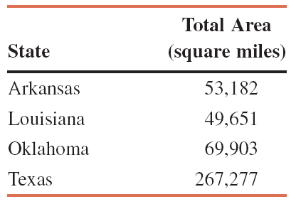
Table 3.4
Prem Mann, Introductory Statistics, 8/E Copyright © 2013 John Wiley & Sons. All rights reserved.

Slide 6
Example 3-11: Solution
Range = Largest value – Smallest Value
= 267,277 – 49,651
= 217,626 square miles
Thus, the total areas of these four states are spread over a range of
217,626 square miles.
Prem Mann, Introductory Statistics, 8/E Copyright © 2013 John Wiley & Sons. All rights reserved.

Slide 7
Variance and Standard Deviation
The standard deviation is the most-used measure of dispersion.
The value of the standard deviation tells how closely the values of a data set are clustered around the mean.
In general, a lower value of the standard deviation for a data set indicates that the values of that data set are spread over a relatively smaller range around the mean.
Prem Mann, Introductory Statistics, 8/E Copyright © 2013 John Wiley & Sons. All rights reserved.

Slide 8
Variance and Standard Deviation
In contrast, a larger value of the standard deviation for a data set indicates that the values of that data set are spread over a relatively larger range around the mean.
The standard deviation is obtained by taking the positive square root of the variance.
Prem Mann, Introductory Statistics, 8/E Copyright © 2013 John Wiley & Sons. All rights reserved.

Slide 9
Variance and Standard Deviation
The variance calculated for population data is denoted by σ² (read as sigma squared), and the variance calculated for sample data is denoted by s².
The standard deviation calculated for population data is denoted by σ, and the standard deviation calculated for sample data is denoted by s.
Consequently, the standard deviation calculated for population data is denoted by σ, and the standard deviation calculated for sample data is denoted by s.
Prem Mann, Introductory Statistics, 8/E Copyright © 2013 John Wiley & Sons. All rights reserved.

Slide 10
Variance and Standard Deviation
Basic Formulas for the Variance and Standard Deviation for Ungrouped Data
where σ² is the population variance, s² is the sample variance, σ is the population standard deviation, and s is the sample standard deviation.
Prem Mann, Introductory Statistics, 8/E Copyright © 2013 John Wiley & Sons. All rights reserved.

Slide 11
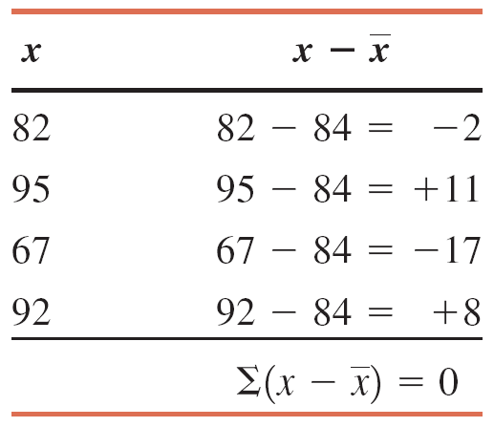
Table 3.5
Prem Mann, Introductory Statistics, 8/E Copyright © 2013 John Wiley & Sons. All rights reserved.

Slide 12
Variance and Standard Deviation
Short-cut Formulas for the Variance and Standard Deviation for Ungrouped Data
where σ² is the population variance, s² is the sample variance, σ is the population standard deviation, and s is the sample standard deviation.
Prem Mann, Introductory Statistics, 8/E Copyright © 2013 John Wiley & Sons. All rights reserved.

Slide 13
Example 3-12
Until about 2009, airline passengers were not charged for checked baggage. Around 2009, however, many U.S. airlines started charging a fee for bags. According to the Bureau of Transportation Statistics, U.S. airlines collected more than $3 billion in baggage fee revenue in 2010. The following table lists the baggage fee revenues of six U.S. airlines for the year 2010. (Note that Delta’s revenue reflects a merger with Northwest. Also note that since then United and Continental have merged; and American filed for bankruptcy and may merge with another airline.)
Find the variance and standard deviation for these data.
Prem Mann, Introductory Statistics, 8/E Copyright © 2013 John Wiley & Sons. All rights reserved.

Slide 14
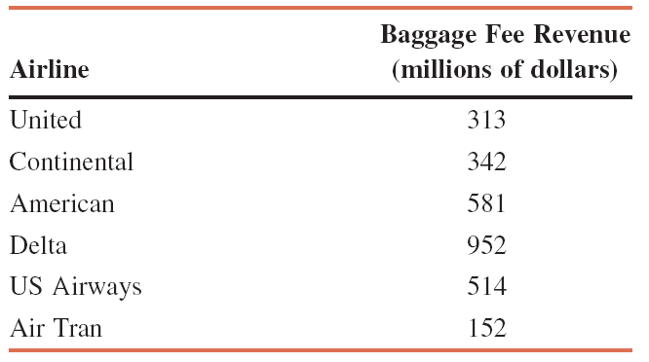
Example 3-12
Prem Mann, Introductory Statistics, 8/E Copyright © 2013 John Wiley & Sons. All rights reserved.

Slide 15
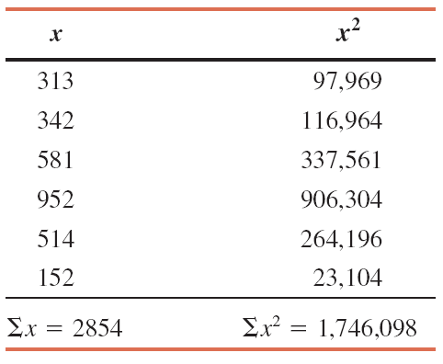
Example 3-12: Solution
Let x denote the 2010 baggage fee revenue (in millions of dollars) of an airline. The values of Σx and Σx² are calculated in Table 3.6.
Prem Mann, Introductory Statistics, 8/E Copyright © 2013 John Wiley & Sons. All rights reserved.

Slide 16
Example 3-12: Solution
Step 1. Calculate Σx
The sum of values in the first column of Table 3.6 gives 2,854.
Step 2. Find Σx²
The results of this step are shown in the second column of Table 3.6, which is 1,746,098.
Prem Mann, Introductory Statistics, 8/E Copyright © 2013 John Wiley & Sons. All rights reserved.

Slide 17
Example 3-12: Solution
Step 3. Determine the variance
Prem Mann, Introductory Statistics, 8/E Copyright © 2013 John Wiley & Sons. All rights reserved.

Slide 18
Example 3-12: Solution
Step 4. Obtain the standard deviation
The standard deviation is obtained by taking the (positive) square root of the variance:
Thus, the standard deviation of the 2010 baggage fee revenues of these six airlines is $278.76 million.
Prem Mann, Introductory Statistics, 8/E Copyright © 2013 John Wiley & Sons. All rights reserved.

Slide 19
Two Observations
The values of the variance and the standard deviation are never negative.
The measurement units of variance are always the square of the measurement units of the original data.
Prem Mann, Introductory Statistics, 8/E Copyright © 2013 John Wiley & Sons. All rights reserved.

Slide 20
Example 3-13
Following are the 2011 earnings (in thousands of dollars)
before taxes for all six employees of a small company.
88.50 108.40 65.50 52.50 79.80 54.60
Calculate the variance and standard deviation for these data.
Prem Mann, Introductory Statistics, 8/E Copyright © 2013 John Wiley & Sons. All rights reserved.

Slide 21
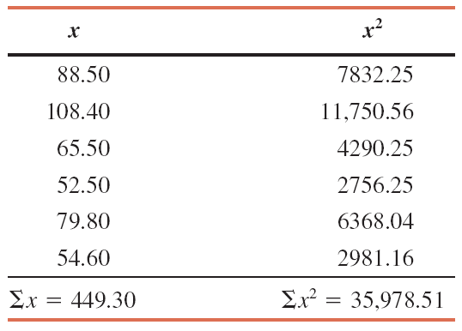
Example 3-13: Solution
Let x denote the 2011 earnings before taxes of an employee of this company. The values of ∑x and ∑x² are calculated in Table 3.7.
Prem Mann, Introductory Statistics, 8/E Copyright © 2013 John Wiley & Sons. All rights reserved.

Slide 22
Example 3-13: Solution
Thus, the standard deviation of the 2011 earnings of all six employees of this company is $19,721.
Prem Mann, Introductory Statistics, 8/E Copyright © 2013 John Wiley & Sons. All rights reserved.

Slide 23
Warning
Note that ∑x² is not the same as (∑x)². The value of ∑x² is obtained by squaring the x values and then adding them. The value of (∑x)² is obtained by squaring the value of ∑x.
Prem Mann, Introductory Statistics, 8/E Copyright © 2013 John Wiley & Sons. All rights reserved.

Slide 24
Population Parameters and Sample Statistics
A numerical measure such as the mean, median, mode, range, variance, or standard deviation calculated for a population data set is called a population parameter, or simply a parameter.
A summary measure calculated for a sample data set is called a sample statistic, or simply a statistic.
Prem Mann, Introductory Statistics, 8/E Copyright © 2013 John Wiley & Sons. All rights reserved.

Slide 25
MEAN, VARIANCE AND STANDARD DEVIATION FOR GROUPED DATA
Mean for Grouped Data
Variance and Standard Deviation for Grouped Data
Prem Mann, Introductory Statistics, 8/E Copyright © 2013 John Wiley & Sons. All rights reserved.

Slide 26
Mean for Grouped Data
Calculating Mean for Grouped Data
Mean for population data:
Mean for sample data:
where m is the midpoint and f is the frequency of a class.
Prem Mann, Introductory Statistics, 8/E Copyright © 2013 John Wiley & Sons. All rights reserved.

Slide 27
Example 3-14
Table 3.8 gives the frequency distribution of the daily commuting times (in minutes) from home to work for all 25 employees of a company.
Calculate the mean of the daily commuting times.
Prem Mann, Introductory Statistics, 8/E Copyright © 2013 John Wiley & Sons. All rights reserved.

Slide 28
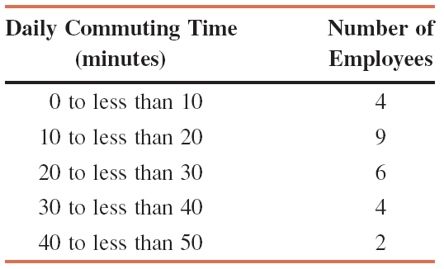
Example 3-14
Prem Mann, Introductory Statistics, 8/E Copyright © 2013 John Wiley & Sons. All rights reserved.

Slide 29
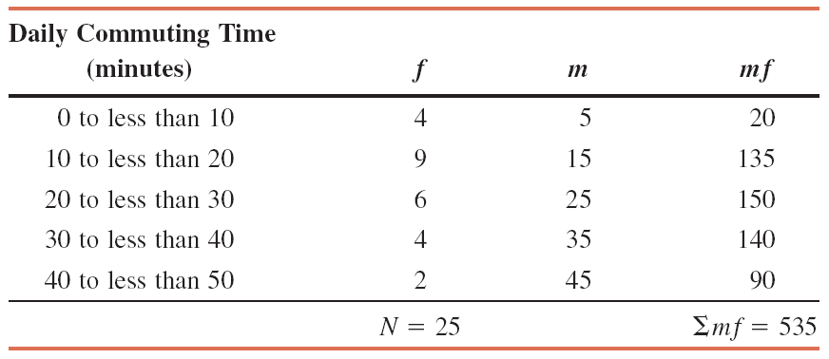
Example 3-14: Solution
Prem Mann, Introductory Statistics, 8/E Copyright © 2013 John Wiley & Sons. All rights reserved.

Slide 30
Example 3-14: Solution
Thus, the employees of this company spend an average of 21.40 minutes a day commuting from home to work.
Prem Mann, Introductory Statistics, 8/E Copyright © 2013 John Wiley & Sons. All rights reserved.

Slide 31
Example 3-15
Table 3.10 gives the frequency distribution of the number of
orders received each day during the past 50 days at the office
of a mail-order company.
Calculate the mean.
Prem Mann, Introductory Statistics, 8/E Copyright © 2013 John Wiley & Sons. All rights reserved.

Slide 32
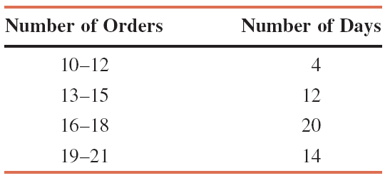
Example 3-15
Prem Mann, Introductory Statistics, 8/E Copyright © 2013 John Wiley & Sons. All rights reserved.

Slide 33
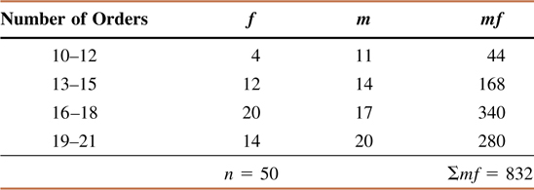
Example 3-15: Solution
Prem Mann, Introductory Statistics, 8/E Copyright © 2013 John Wiley & Sons. All rights reserved.

Slide 34
Example 3-15: Solution
Thus, this mail-order company received an average of 16.64 orders per day during these 50 days.
Prem Mann, Introductory Statistics, 8/E Copyright © 2013 John Wiley & Sons. All rights reserved.

Slide 35
Variance and Standard Deviation for Grouped Data
Basic Formulas for the Variance and Standard Deviation for
Grouped Data
where σ² is the population variance, s² is the sample variance,
and m is the midpoint of a class. In either case, the standard
deviation is obtained by taking the positive square root of the
variance.
Prem Mann, Introductory Statistics, 8/E Copyright © 2013 John Wiley & Sons. All rights reserved.

Slide 36
Variance and Standard Deviation for Grouped Data
Short-Cut Formulas for the Variance and Standard Deviation
for Grouped Data
where σ² is the population variance, s² is the sample variance,
and m is the midpoint of a class.
Prem Mann, Introductory Statistics, 8/E Copyright © 2013 John Wiley & Sons. All rights reserved.

Slide 37
Variance and Standard Deviation for Grouped Data
Short-cut Formulas for the Variance and Standard Deviation for
Grouped Data
The standard deviation is obtained by taking the positive
square root of the variance.
Population standard deviation:
Sample standard deviation:
Prem Mann, Introductory Statistics, 8/E Copyright © 2013 John Wiley & Sons. All rights reserved.

Slide 38
Example 3-16
The following data, reproduced from Table 3.8 of Example 3-14,
give the frequency distribution of the daily commuting times (in
minutes) from home to work for all 25 employees of a company.
Calculate the variance and standard deviation.
Prem Mann, Introductory Statistics, 8/E Copyright © 2013 John Wiley & Sons. All rights reserved.

Slide 39
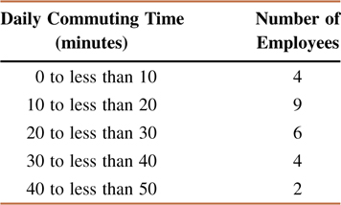
Example 3-16
Prem Mann, Introductory Statistics, 8/E Copyright © 2013 John Wiley & Sons. All rights reserved.

Slide 40
Example 3-16: Solution
Prem Mann, Introductory Statistics, 8/E Copyright © 2013 John Wiley & Sons. All rights reserved.

Slide 41
Example 3-16: Solution
Thus, the standard deviation of the daily commuting times for these employees is 11.62 minutes.
Prem Mann, Introductory Statistics, 8/E Copyright © 2013 John Wiley & Sons. All rights reserved.

Slide 42
Example 3-17
The following data, reproduced from Table 3.10 of Example 3-
15, give the frequency distribution of the number of orders
received each day during the past 50 days at the office of a
mail-order company.
Calculate the variance and standard deviation.
Prem Mann, Introductory Statistics, 8/E Copyright © 2013 John Wiley & Sons. All rights reserved.

Slide 43
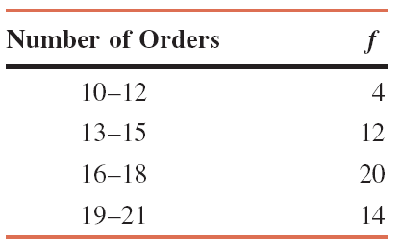
Example 3-17
Prem Mann, Introductory Statistics, 8/E Copyright © 2013 John Wiley & Sons. All rights reserved.

Slide 44
Example 3-17: Solution
Prem Mann, Introductory Statistics, 8/E Copyright © 2013 John Wiley & Sons. All rights reserved.

Slide 45
Example 3-17: Solution
Thus, the standard deviation of the number of orders received at the office of this mail-order company during the past 50 days is 2.75.
Prem Mann, Introductory Statistics, 8/E Copyright © 2013 John Wiley & Sons. All rights reserved.

