Slide 1
CHAPTER 3
NUMERICAL DESCRIPTIVE MEASURES (Part C)
Prem Mann, Introductory Statistics, 8/E Copyright © 2013 John Wiley & Sons. All rights reserved.

Slide 2
USE OF STANDARD DEVIATION
Chebyshev’s Theorem
Empirical Rule
Prem Mann, Introductory Statistics, 8/E Copyright © 2013 John Wiley & Sons. All rights reserved.

Slide 3
Chebyshev’s Theorem
Definition
The proportion of any distribution that lies K standard deviation of the mean is at least: 1 – 1/k², where K is any positive number greater than 1.
By using the mean and standard deviation, we can find the proportion of the total observations that fall within a given interval about the mean.
The value of k is obtained by dividing the distance between the mean and each point by the standard deviation.
(K= Distance between the mean/Standard Deviation)
Prem Mann, Introductory Statistics, 8/E Copyright © 2013 John Wiley & Sons. All rights reserved.

Slide 4
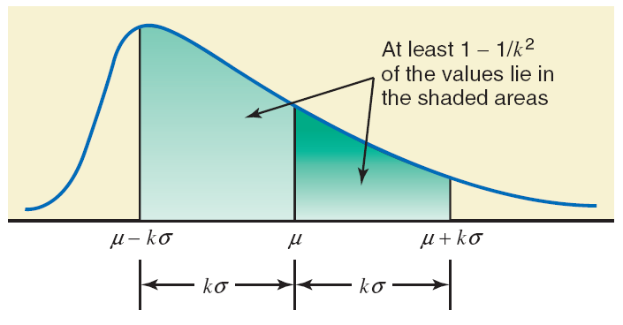
Figure 3.5 Chebyshev’s theorem.
Prem Mann, Introductory Statistics, 8/E Copyright © 2013 John Wiley & Sons. All rights reserved.

Slide 5
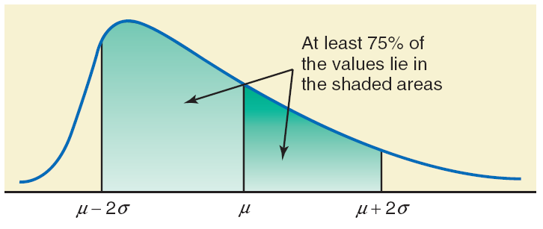
Figure 3.6 Percentage of values within two standard deviations of the mean for Chebyshev’s theorem.
Prem Mann, Introductory Statistics, 8/E Copyright © 2013 John Wiley & Sons. All rights reserved.

Slide 6
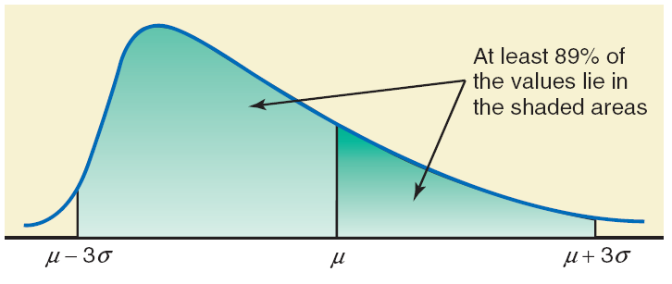
Figure 3.7 Percentage of values within three standard deviations of the mean for Chebyshev’s theorem.
Prem Mann, Introductory Statistics, 8/E Copyright © 2013 John Wiley & Sons. All rights reserved.

Slide 7
Example 3-18
The average systolic blood pressure for 4000 women who were screened for high blood pressure was found to be 187 mm Hg with a standard deviation of 22. Using Chebyshev’s theorem, find at least what percentage of women in this group have a systolic blood pressure between 143 and 231 mm Hg.
Prem Mann, Introductory Statistics, 8/E Copyright © 2013 John Wiley & Sons. All rights reserved.

Slide 8
Example 3-18: Solution
Let μ and σ be the mean and the standard deviation, respectively, of the systolic blood pressures of these women.
μ = 187 and σ = 22
Prem Mann, Introductory Statistics, 8/E Copyright © 2013 John Wiley & Sons. All rights reserved.

Slide 9
Example 3-18: Solution
The value of k is obtained by dividing the distance between the mean and each point by the standard deviation. Thus
k = 44/22 = 2
Hence, according to Chebyshev's theorem, at least 75% of the women have systolic blood pressure between 143 and 231 mm Hg. This percentage is shown in Figure 3.8.
Prem Mann, Introductory Statistics, 8/E Copyright © 2013 John Wiley & Sons. All rights reserved.

Slide 10
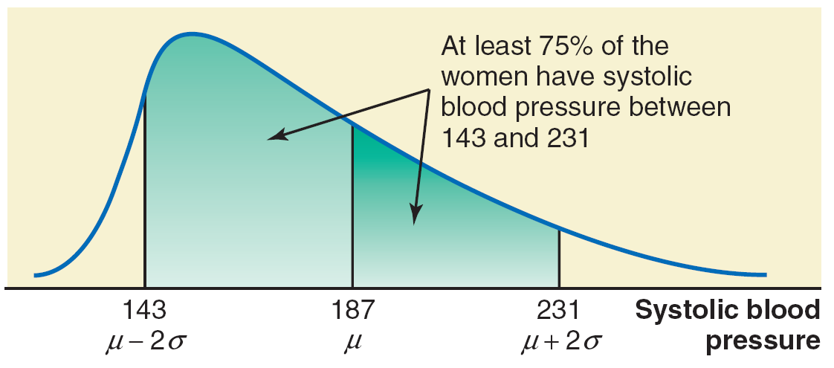
Figure 3.8 Percentage of women with systolic blood pressure between 143 and 231.
Prem Mann, Introductory Statistics, 8/E Copyright © 2013 John Wiley & Sons. All rights reserved.

Slide 11
Empirical Rule
For a bell shaped distribution, approximately
68% of the observations lie within one standard deviation of the mean
95% of the observations lie within two standard deviations of the mean
99.7% of the observations lie within three standard deviations of the mean
Prem Mann, Introductory Statistics, 8/E Copyright © 2013 John Wiley & Sons. All rights reserved.

Slide 12
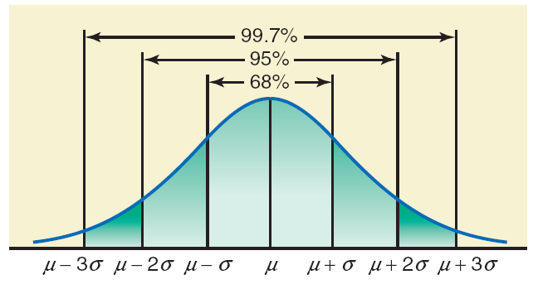
Figure 3.9 Illustration of the empirical rule.
Prem Mann, Introductory Statistics, 8/E Copyright © 2013 John Wiley & Sons. All rights reserved.

Slide 13
Example 3-19
The age distribution of a sample of 5000 persons is bell-shaped with a mean of 40 years and a standard deviation of 12 years. Determine the approximate percentage of people who are 16 to 64 years old.
Prem Mann, Introductory Statistics, 8/E Copyright © 2013 John Wiley & Sons. All rights reserved.

Slide 14
Example 3-19: Solution
From the given information, for this distribution,
x = 40 and s = 12 years
Each of the two points, 16 and 64, is 24 units away from the mean.
Because the area within two standard deviations of the mean is approximately 95% for a bell-shaped curve, approximately 95% of the people in the sample are 16 to 64 years old.
Prem Mann, Introductory Statistics, 8/E Copyright © 2013 John Wiley & Sons. All rights reserved.

Slide 15
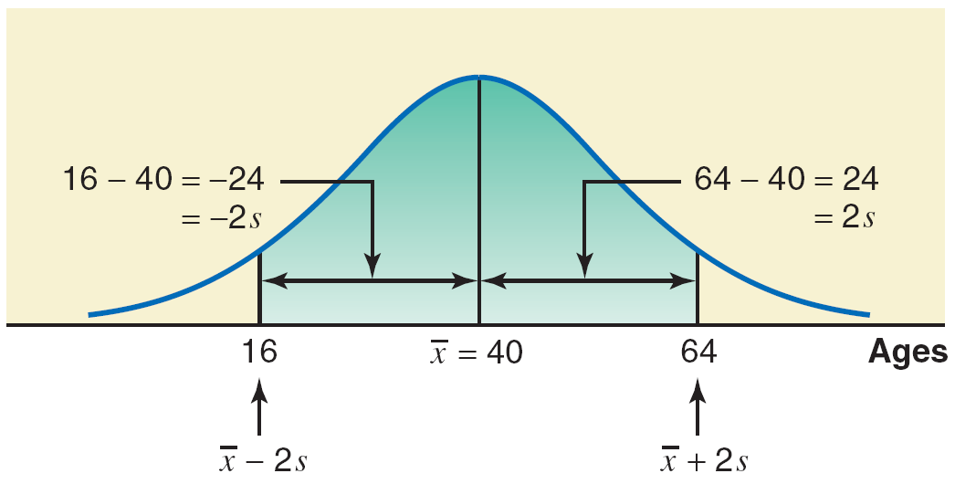
Figure 3.10 Percentage of people who are 16 to 64 years old.
Prem Mann, Introductory Statistics, 8/E Copyright © 2013 John Wiley & Sons. All rights reserved.

Slide 16
MEASURES OF POSITION
Quartiles and Interquartile Range
Percentiles and Percentile Rank
Prem Mann, Introductory Statistics, 8/E Copyright © 2013 John Wiley & Sons. All rights reserved.

Slide 17
Quartiles and Interquartile Range
Definition
Quartiles are three summary measures that divide a ranked data set into four equal parts. The second quartile is the same as the median of a data set. The first quartile is the value of the middle term among the observations that are less than the median, and the third quartile is the value of the middle term among the observations that are greater than the median.
Prem Mann, Introductory Statistics, 8/E Copyright © 2013 John Wiley & Sons. All rights reserved.

Slide 18
Figure 3.11 Quartiles.
Prem Mann, Introductory Statistics, 8/E Copyright © 2013 John Wiley & Sons. All rights reserved.

Slide 19
Quartiles and Interquartile Range
Calculating Interquartile Range
The difference between the third and the first quartiles gives the interquartile range; that is,
IQR = Interquartile range = Q₃ – Q₁
Prem Mann, Introductory Statistics, 8/E Copyright © 2013 John Wiley & Sons. All rights reserved.

Slide 20
Example 3-20
Table 3.3 in Example 3-5 gave the total compensations (in millions of dollars) for the year 2010 of the 12 highest-paid CEOs of U.S. companies. That table is reproduced on the next slide.
(a) Find the values of the three quartiles. Where does the total compensation of Michael D. White (CEO of DirecTV) fall in relation to these quartiles?
(b) Find the interquartile range.
Prem Mann, Introductory Statistics, 8/E Copyright © 2013 John Wiley & Sons. All rights reserved.

Slide 21
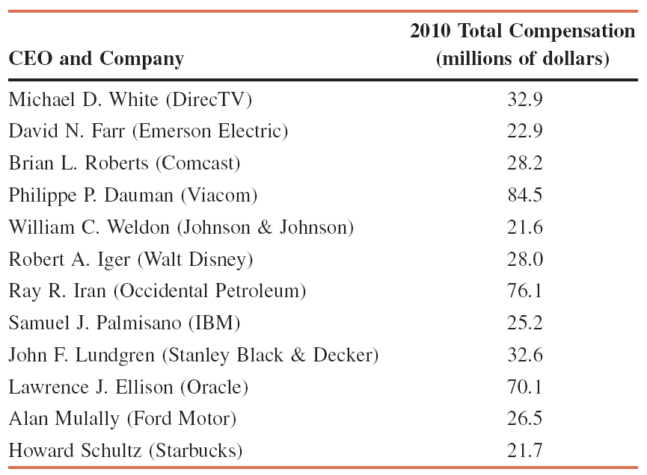
Example 3-20
Prem Mann, Introductory Statistics, 8/E Copyright © 2013 John Wiley & Sons. All rights reserved.

Slide 22
Example 3-20: Solution
(a)
By looking at the position of $32.9 million (total compensation of Michael D. White, CEO of DirecTV), we can state that this value lies in the bottom 75% of the 2010 total compensation. This value falls between the second and third quartiles.
Prem Mann, Introductory Statistics, 8/E Copyright © 2013 John Wiley & Sons. All rights reserved.

Slide 23
Example 3-20: Solution
(b) The interquartile range is given by the difference between the values of the third and first quartiles. Thus
IQR = Interquartile range = Q₃ – Q₁
= 51.5 – 24.05 = $27.45 million
Prem Mann, Introductory Statistics, 8/E Copyright © 2013 John Wiley & Sons. All rights reserved.

Slide 24
Example 3-21
The following are the ages (in years) of nine employees of an insurance company:
47 28 39 51 33 37 59 24 33
(a) Find the values of the three quartiles. Where does the age of 28 years fall in relation to the ages of the employees?
(b) Find the interquartile range.
Prem Mann, Introductory Statistics, 8/E Copyright © 2013 John Wiley & Sons. All rights reserved.

Slide 25
Example 3-21: Solution
(a)
The age of 28 falls in the lowest 25% of the ages.
Prem Mann, Introductory Statistics, 8/E Copyright © 2013 John Wiley & Sons. All rights reserved.

Slide 26
Example 3-21: Solution
(b) The interquartile range is
IQR = Interquartile range = Q₃ – Q₁
= 49 – 30.5
= 18.5 years
Prem Mann, Introductory Statistics, 8/E Copyright © 2013 John Wiley & Sons. All rights reserved.

Slide 27
Percentiles and Percentile Rank
Prem Mann, Introductory Statistics, 8/E Copyright © 2013 John Wiley & Sons. All rights reserved.

Slide 28
Percentiles and Percentile Rank
Calculating Percentiles
The (approximate) value of the k th percentile, denoted by P_{k}, is
where k denotes the number of the percentile and n represents the sample size.
Prem Mann, Introductory Statistics, 8/E Copyright © 2013 John Wiley & Sons. All rights reserved.

Slide 29
Example 3-22
Refer to the data on total compensations (in millions of dollars) for the year 2010 of the 12 highest-paid CEOs of U.S. companies given in Example 3-20. Find the value of the 60th percentile. Give a brief interpretation of the 60th percentile.
Prem Mann, Introductory Statistics, 8/E Copyright © 2013 John Wiley & Sons. All rights reserved.

Slide 30
Example 3-22: Solution
The data arranged in increasing order is as follows:
21.6 21.7 22.9 25.2 26.5 28.0 28.2 32.6 32.9 70.1 76.1 84.5
The position of the 60th percentile is
Prem Mann, Introductory Statistics, 8/E Copyright © 2013 John Wiley & Sons. All rights reserved.

Slide 31
Example 3-22: Solution
The value of the 7.20th term can be approximated by the value of the 7th term in the ranked data. Therefore,
P₆₀ = 60th percentile = 28.2 = $28.2 million
Thus, approximately 60% of these 12 CEOs had 2010 total compensations less than or equal to $28.2 million.
Prem Mann, Introductory Statistics, 8/E Copyright © 2013 John Wiley & Sons. All rights reserved.

Slide 32
Percentiles and Percentile Rank
Finding Percentile Rank of a Value
Prem Mann, Introductory Statistics, 8/E Copyright © 2013 John Wiley & Sons. All rights reserved.

Slide 33
Example 3-23
Refer to the data on total compensations (in millions of dollars) for the year 2010 of the 12 highest-paid CEOs of U.S. companies given in Example 3-20. Find the percentile rank for less than $26.5 million (2010 total compensation of Alan Mulally, CEO of Ford Motor). Give a brief interpretation of this percentile rank.
Prem Mann, Introductory Statistics, 8/E Copyright © 2013 John Wiley & Sons. All rights reserved.

Slide 34
Example 3-23: Solution
The data on revenues arranged in increasing order is as follows:
21.6 21.7 22.9 25.2 26.5 28.0 28.2 32.6 32.9 70.1 76.1 84.5
In this data set, 4 of the 12 values are less than $26.5 million. Hence,
Prem Mann, Introductory Statistics, 8/E Copyright © 2013 John Wiley & Sons. All rights reserved.

