Slide 1
CHAPTER 5 (Part A)
DISCRETE RANDOM VARIABLES AND THEIR PROBABILITY DISTRIBUTIONS
Prem Mann, Introductory Statistics, 8/E Copyright © 2013 John Wiley & Sons. All rights reserved.

Slide 2
RANDOM VARIABLES
Discrete Random Variable
Continuous Random Variable
Prem Mann, Introductory Statistics, 8/E Copyright © 2013 John Wiley & Sons. All rights reserved.

Slide 3
Discrete Random Variable
Definition
A random variable that assumes countable values is called a discrete random variable.
Prem Mann, Introductory Statistics, 8/E Copyright © 2013 John Wiley & Sons. All rights reserved.

Slide 4
Examples of discrete random variables
The number of cars sold at a dealership during a given month
The number of houses in a certain block
The number of fish caught on a fishing trip
The number of complaints received at the office of an airline on a given day
The number of customers who visit a bank during any given hour
The number of heads obtained in three tosses of a coin
Prem Mann, Introductory Statistics, 8/E Copyright © 2013 John Wiley & Sons. All rights reserved.

Slide 5
Continuous Random Variable
Definition
A random variable that can assume any value contained in one or more intervals is called a continuous random variable.
Prem Mann, Introductory Statistics, 8/E Copyright © 2013 John Wiley & Sons. All rights reserved.

Slide 6
Examples of continuous random variables
The length of a room
The time taken to commute from home to work
The amount of milk in a gallon (note that we do not expect “a gallon” to contain exactly one gallon of milk but either slightly more or slightly less than one gallon)
The weight of a letter
The price of a house
Prem Mann, Introductory Statistics, 8/E Copyright © 2013 John Wiley & Sons. All rights reserved.

Slide 7
PROBABLITY DISTRIBUTION OF A DISCRETE RANDOM VARIABLE
Definition
The probability distribution of a discrete random variable lists all the possible values that the random variable can assume and their corresponding probabilities.
Prem Mann, Introductory Statistics, 8/E Copyright © 2013 John Wiley & Sons. All rights reserved.

Slide 8
Two Characteristics of a Probability Distribution
The probability distribution of a discrete random variable possesses the following two characteristics.
1. 0 ≤ P(x) ≤ 1 for each value of x
2. Σ P(x) = 1.
Prem Mann, Introductory Statistics, 8/E Copyright © 2013 John Wiley & Sons. All rights reserved.

Slide 9
Example
Each of the following tables lists certain values of x and their probabilities. Determine whether or not each table represents a valid probability distribution.
(a) No, since the sum of all probabilities is not equal to 1.0.
(b) Yes.
(c) No, since one of the probabilities is negative.
Prem Mann, Introductory Statistics, 8/E Copyright © 2013 John Wiley & Sons. All rights reserved.

Slide 10
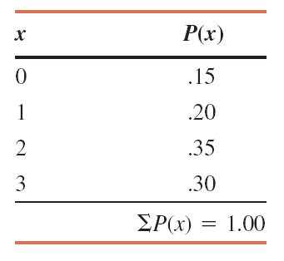
Probability Distribution of the Number of Breakdowns per week for a machine based on past data.
(a) Present this probability distribution graphically.
(b) Find the probability that the number of breakdowns for this machine during a given week is
i. exactly 2
ii. 0 to 2
iii. more than 1
iv. at most 1
Prem Mann, Introductory Statistics, 8/E Copyright © 2013 John Wiley & Sons. All rights reserved.

Slide 11
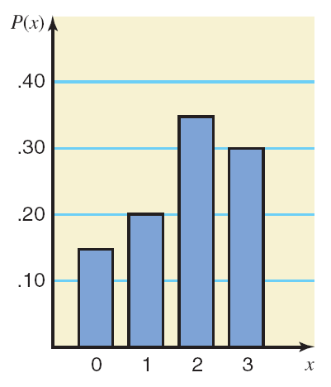
a) Graphical presentation of the probability distribution
Prem Mann, Introductory Statistics, 8/E Copyright © 2013 John Wiley & Sons. All rights reserved.

Slide 12
Solution (b)
i. P(exactly 2 breakdowns) = P(x = 2) = .35
ii. P(0 to 2 breakdowns) = P(0 ≤ x ≤ 2) = P(x = 0) + P(x = 1) + P(x = 2) = .15 + .20 + .35 = .70
iii. P(more then 1 breakdown) = P(x > 1) = P(x = 2) + P(x = 3)
= .35 +.30 = .65
iv. P(at most one breakdown) = P(x ≤ 1) = P(x = 0) + P(x = 1)
= .15 + .20 = .35
Prem Mann, Introductory Statistics, 8/E Copyright © 2013 John Wiley & Sons. All rights reserved.

Slide 13
Example
According to a survey, 60% of all students at a large university suffer from math anxiety. Two students are randomly selected from this university. Let x denote the number of students in this sample who suffer from math anxiety. Develop the probability distribution of x.
Prem Mann, Introductory Statistics, 8/E Copyright © 2013 John Wiley & Sons. All rights reserved.

Slide 14
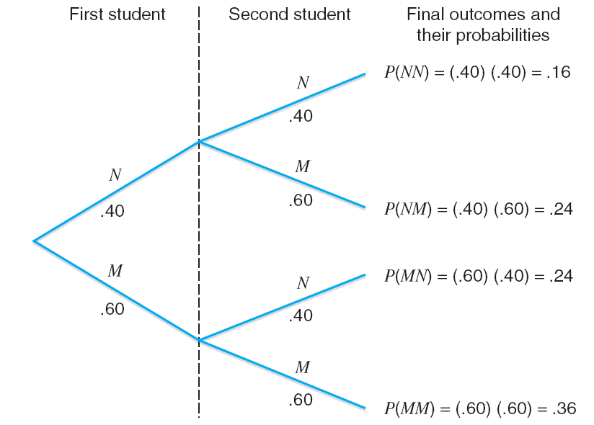
Tree diagram.
Prem Mann, Introductory Statistics, 8/E Copyright © 2013 John Wiley & Sons. All rights reserved.

Slide 15
Solution
Let us define the following two events:
N = the student selected does not suffer from math
anxiety M = the student selected suffers from math anxiety P(x = 0) = P(NN) = .16
P(x = 1) = P(NM or MN) = P(NM) + P(MN)
= .24 + .24 = .48
P(x = 2) = P(MM) = .36
Prem Mann, Introductory Statistics, 8/E Copyright © 2013 John Wiley & Sons. All rights reserved.

Slide 16
Probability Distribution of the Number of Students with Math Anxiety in a Sample of Two Students
Prem Mann, Introductory Statistics, 8/E Copyright © 2013 John Wiley & Sons. All rights reserved.

