Slide 1
CHAPTER 5 (Part B)
DISCRETE RANDOM VARIABLES AND THEIR PROBABILITY DISTRIBUTIONS
Prem Mann, Introductory Statistics, 8/E Copyright © 2013 John Wiley & Sons. All rights reserved.

Slide 2
MEAN AMD STANDARD DEVIATION OF A DISCRETE RANDOM VARIABLE
The mean of a discrete variable x is the value that is expected to occur per repetition, on average, if an experiment is repeated a large number of times. It is denoted by µ and calculated as
µ = Σ x P(x)
Prem Mann, Introductory Statistics, 8/E Copyright © 2013 John Wiley & Sons. All rights reserved.

Slide 3
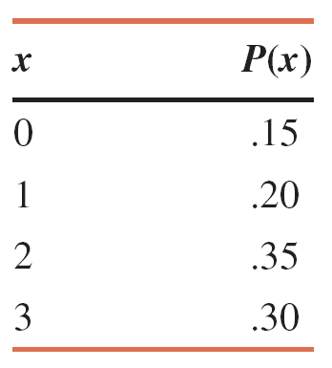
Example
Find the mean number of breakdowns per week for this machine.
Prem Mann, Introductory Statistics, 8/E Copyright © 2013 John Wiley & Sons. All rights reserved.

Slide 4
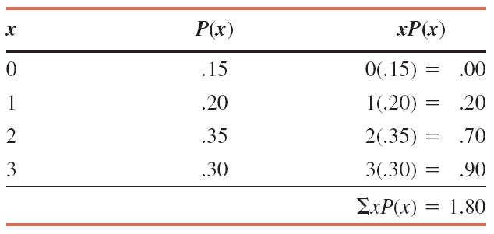
Calculating the Mean for the Probability Distribution of Breakdowns
The mean is µ = Σx P(x) = 1.80
Prem Mann, Introductory Statistics, 8/E Copyright © 2013 John Wiley & Sons. All rights reserved.

Slide 5
MEAN AND STANDARD DEVIATION OF A DISCRETE RANDOM VARIABLE
The standard deviation of a discrete random variable x measures the spread of its probability distribution and is computed as
Prem Mann, Introductory Statistics, 8/E Copyright © 2013 John Wiley & Sons. All rights reserved.

Slide 6
Example
Baier’s Electronics manufactures computer parts that are supplied to many computer companies. Despite the fact that two quality control inspectors at Baier’s Electronics check every part for defects before it is shipped to another company, a few defective parts do pass through these inspections undetected. Let x denote the number of defective computer parts in a shipment of 400. The following table gives the probability distribution of x.
Compute the standard deviation of x.
Prem Mann, Introductory Statistics, 8/E Copyright © 2013 John Wiley & Sons. All rights reserved.

Slide 7
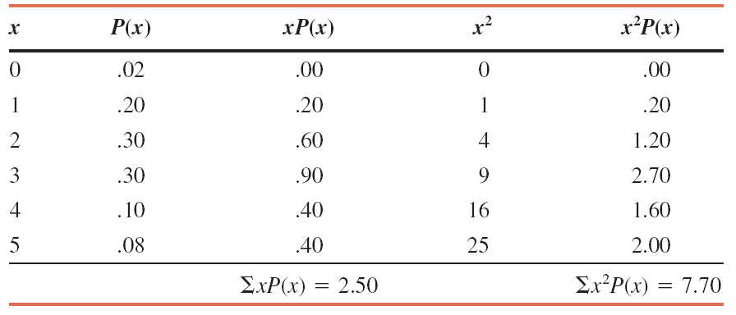
Example : Solution Table Computations to Find the Standard Deviation
Prem Mann, Introductory Statistics, 8/E Copyright © 2013 John Wiley & Sons. All rights reserved.

Slide 8
Example: Solution
Prem Mann, Introductory Statistics, 8/E Copyright © 2013 John Wiley & Sons. All rights reserved.

Slide 9
THE BINOMIAL PROBABILITY DISTRIBUTION
Conditions of a Binomial Experiment
A binomial experiment must satisfy the following four
conditions.
1. There are n identical trials.
2. Each trail has only two possible outcomes.
3. The probabilities of the two outcomes remain constant.
4. The trials are independent.
Prem Mann, Introductory Statistics, 8/E Copyright © 2013 John Wiley & Sons. All rights reserved.

Slide 10
Example
Consider the experiment consisting of 10 tosses of a coin. Determine whether or not it is a binomial experiment.
Prem Mann, Introductory Statistics, 8/E Copyright © 2013 John Wiley & Sons. All rights reserved.

Slide 11
Example: Solution
1. There are a total of 10 trials (tosses), and they are all identical. Here, n=10.
2. Each trial (toss) has only two possible outcomes: a head and a tail.
3. The probability of obtaining a head (a success) is ½ and that of a tail (a failure) is ½ for any toss. That is,
p = P(H) = ½ and q = P(T) = ½
4. The trials (tosses) are independent.
Consequently, the experiment consisting of 10 tosses is a binomial experiment.
Prem Mann, Introductory Statistics, 8/E Copyright © 2013 John Wiley & Sons. All rights reserved.

Slide 12
The Binomial Probability Distribution and Binomial Formula
For a binomial experiment, the probability of exactly x successes in n trials is given by the binomial formula
where
n = total number of trials
p = probability of success
q = 1 – p = probability of failure
x = number of successes in n trials
n - x = number of failures in n trials
Prem Mann, Introductory Statistics, 8/E Copyright © 2013 John Wiley & Sons. All rights reserved.

Slide 13
Example
Five percent of all DVD players manufactured by a large electronics company are defective. A quality control inspector randomly selects three DVD player from the production line. What is the probability that exactly one of these three DVD players is defective?
Prem Mann, Introductory Statistics, 8/E Copyright © 2013 John Wiley & Sons. All rights reserved.

Slide 14
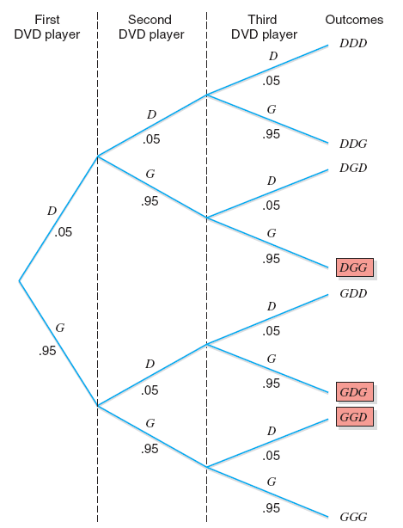
Tree diagram for selecting three DVD Players.
Prem Mann, Introductory Statistics, 8/E Copyright © 2013 John Wiley & Sons. All rights reserved.

Slide 15
Example: Solution
Let
D = a selected DVD player is defective P(D) = .05
G = a selected DVD player is good P(G) = .95
P(DGG) = P(D) P(G) P(G)
= (.05)(.95)(.95) = .0451
P(GDG) = P(G) P(D) P(G)
= (.95)(.05)(.95) = .0451
P(GGD) = P(G) P(G) P(D)
= (.95)(.95)(.05) = .0451
Prem Mann, Introductory Statistics, 8/E Copyright © 2013 John Wiley & Sons. All rights reserved.

Slide 16
Example: Solution
P(1 DVD player in 3 is defective)
= P(DGG or GDG or GGD) = P(DGG) + P(GDG) + P(GGD) = .0451 + .0451 + .0451 = .1353
Prem Mann, Introductory Statistics, 8/E Copyright © 2013 John Wiley & Sons. All rights reserved.

Slide 17
Solution
n = total number of trials = 3 DVD players x = number of successes = number of defective DVD players
= 1 n – x = number of failures = number of good DVD players
= 3 - 1 = 2 p = P(success) = .05 q = P(failure) = 1 – p = .95
Prem Mann, Introductory Statistics, 8/E Copyright © 2013 John Wiley & Sons. All rights reserved.

Slide 18
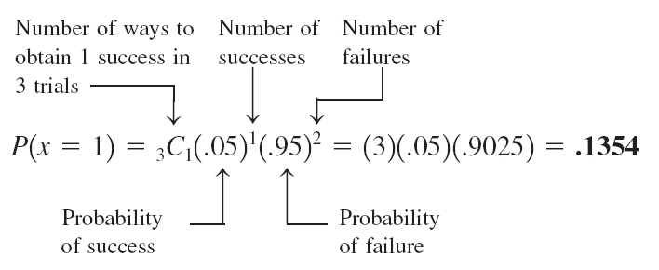
Solution
The probability of selecting exactly one defective DVD player is
Prem Mann, Introductory Statistics, 8/E Copyright © 2013 John Wiley & Sons. All rights reserved.

Slide 19
Mean and Standard Deviation of the Binomial Distribution
The mean and standard deviation of a binomial distribution are, respectively,
where n is the total number of trails, p is the probability of success, and q is the probability of failure.
Prem Mann, Introductory Statistics, 8/E Copyright © 2013 John Wiley & Sons. All rights reserved.

Slide 20
Example
In a 2011 Time magazine poll, American adults were asked, “When children today in the U.S. grow up, do you think they will be better off or worse off than people are now?” Of these adults, 52% said worse. Assume that this result is true for the current population of U.S. adults. A sample of 50 adults is selected. Let x be the number of adults in this sample who hold the above-mentioned opinion. Find the mean and standard deviation of the probability distribution of x.
Prem Mann, Introductory Statistics, 8/E Copyright © 2013 John Wiley & Sons. All rights reserved.

Slide 21
Example: Solution
n = 50, p = .52, and q = .48
Using the formulas for the mean and standard deviation of
the binomial distribution,
Prem Mann, Introductory Statistics, 8/E Copyright © 2013 John Wiley & Sons. All rights reserved.

