Slide 1
CHAPTER 6
CONTINUOUS RANDOM VARIABLES AND THE NORMAL DISTRIBUTION
Prem Mann, Introductory Statistics, 8/E Copyright © 2013 John Wiley & Sons. All rights reserved.

Slide 2
CONTINUOUS PROBABILITY DISTRIBUTION
Two characteristics
1. The probability that x assumes a value in any interval lies in
the range 0 to 1
2. The total probability of all the (mutually exclusive) intervals
within which x can assume a value of 1.0
Prem Mann, Introductory Statistics, 8/E Copyright © 2013 John Wiley & Sons. All rights reserved.

Slide 3
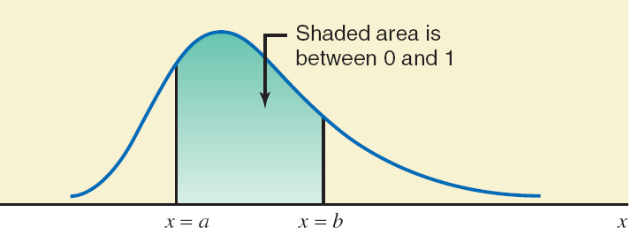
Area under a curve between two points.
Prem Mann, Introductory Statistics, 8/E Copyright © 2013 John Wiley & Sons. All rights reserved.

Slide 4
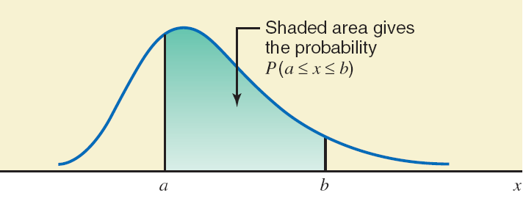
Area under the curve as probability.
Prem Mann, Introductory Statistics, 8/E Copyright © 2013 John Wiley & Sons. All rights reserved.

Slide 5
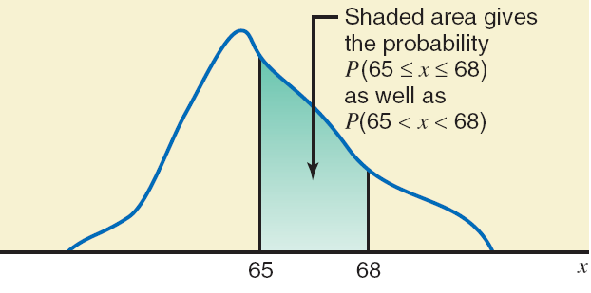
Probability “from 65 to 68” and “between 65 and 68”.
Prem Mann, Introductory Statistics, 8/E Copyright © 2013 John Wiley & Sons. All rights reserved.

Slide 6
NORMAL PROBABILITY DISTRIBUTION
Normal Probability Distribution
A normal probability distribution , when plotted, gives a bell-shaped curve such that:
1. The total area under the curve is 1.0.
2. The curve is symmetric about the mean.
3. The two tails of the curve extend indefinitely.
Prem Mann, Introductory Statistics, 8/E Copyright © 2013 John Wiley & Sons. All rights reserved.

Slide 7
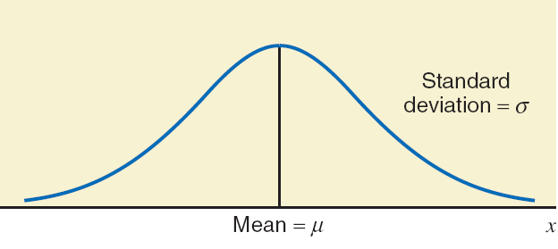
Normal distribution with mean μ and standard deviation σ.
Prem Mann, Introductory Statistics, 8/E Copyright © 2013 John Wiley & Sons. All rights reserved.

Slide 8
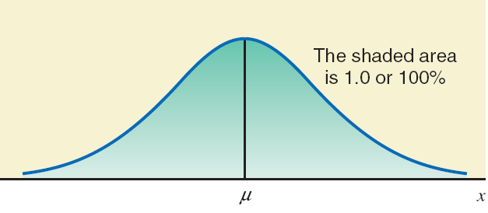
Total area under a normal curve.
Prem Mann, Introductory Statistics, 8/E Copyright © 2013 John Wiley & Sons. All rights reserved.

Slide 9
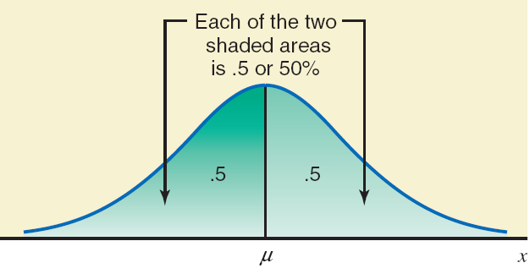
A normal curve is symmetric about the mean.
Prem Mann, Introductory Statistics, 8/E Copyright © 2013 John Wiley & Sons. All rights reserved.

Slide 10
STANDARD NORMAL DISTRIBTUION
Definition
z Values or z Scores
The units marked on the horizontal axis of the standard normal curve are denoted by z and are called the z values or z scores. A specific value of z gives the distance between the mean and the point represented by z in terms of the standard deviation.
Prem Mann, Introductory Statistics, 8/E Copyright © 2013 John Wiley & Sons. All rights reserved.

Slide 11
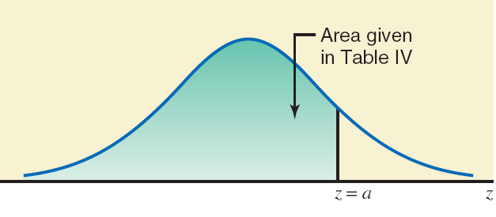
Area under the standard normal curve.
Prem Mann, Introductory Statistics, 8/E Copyright © 2013 John Wiley & Sons. All rights reserved.

Slide 12
Example
Find the area under the standard normal curve to the left of z = 1.95.
Prem Mann, Introductory Statistics, 8/E Copyright © 2013 John Wiley & Sons. All rights reserved.

Slide 13
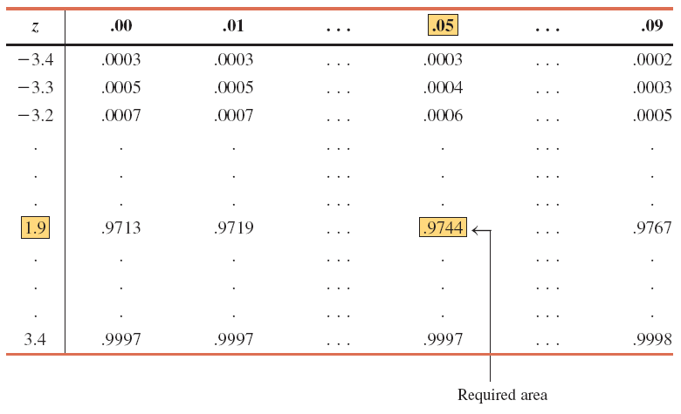
Table - Area Under the Standard Normal Curve to the Left of z = 1.95
Prem Mann, Introductory Statistics, 8/E Copyright © 2013 John Wiley & Sons. All rights reserved.

Slide 14
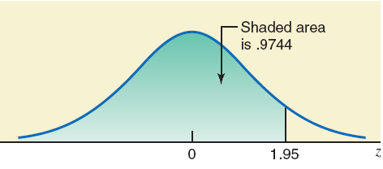
Area to the left of z = 1.95.
Prem Mann, Introductory Statistics, 8/E Copyright © 2013 John Wiley & Sons. All rights reserved.

Slide 15
Example
Find the following probabilities for the standard normal curve.
(a) P (1.19 < z < 2.12)
(b) P (-1.56 < z < 2.31)
(c) P (z > -.75)
Prem Mann, Introductory Statistics, 8/E Copyright © 2013 John Wiley & Sons. All rights reserved.

Slide 16
Example : Solution
(a) P (1.19 < z < 2.12) = Area between 1.19 and 2.12 = .9830 - .8830
= .1000
Prem Mann, Introductory Statistics, 8/E Copyright © 2013 John Wiley & Sons. All rights reserved.

Slide 17
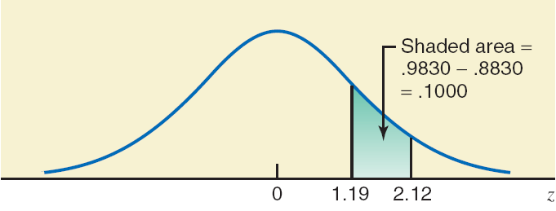
Finding P (1.19 < z < 2.12).
Prem Mann, Introductory Statistics, 8/E Copyright © 2013 John Wiley & Sons. All rights reserved.

Slide 18
Example: Solution
(b) P (-1.56 < z < 2.31) = Area between -1.56 and 2.31
= .9896 - .0594
= .9302
Prem Mann, Introductory Statistics, 8/E Copyright © 2013 John Wiley & Sons. All rights reserved.

Slide 19
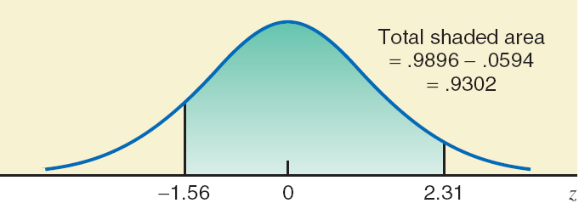
Finding P (-1.56 < z < 2.31).
Prem Mann, Introductory Statistics, 8/E Copyright © 2013 John Wiley & Sons. All rights reserved.

Slide 20
Example : Solution
(c) P (z > -.75) = Area to the right of -.75
= 1.0 - .2266
= .7734
Prem Mann, Introductory Statistics, 8/E Copyright © 2013 John Wiley & Sons. All rights reserved.

Slide 21
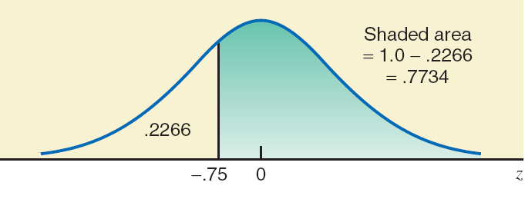
Finding P (z > -.75).
Prem Mann, Introductory Statistics, 8/E Copyright © 2013 John Wiley & Sons. All rights reserved.

Slide 22
STANDARDIZING A NORMAL DISTRIBUTION
Converting an x Value to a z Value
For a normal random variable x, a particular value of x can be converted to its corresponding z value by using the formula
where μ and σ are the mean and standard deviation of the normal distribution of x, respectively.
Prem Mann, Introductory Statistics, 8/E Copyright © 2013 John Wiley & Sons. All rights reserved.

Slide 23
Example
Let x be a continuous random variable that has a normal distribution with a mean of 50 and a standard deviation of 10. Convert the following x values to z values and find the probability to the left of these points.
(a) x = 55
(b) x = 35
Prem Mann, Introductory Statistics, 8/E Copyright © 2013 John Wiley & Sons. All rights reserved.

Slide 24
Example: Solution
(a) x = 55
P(x < 55) = P(z < .50) = .6915
Prem Mann, Introductory Statistics, 8/E Copyright © 2013 John Wiley & Sons. All rights reserved.

Slide 25
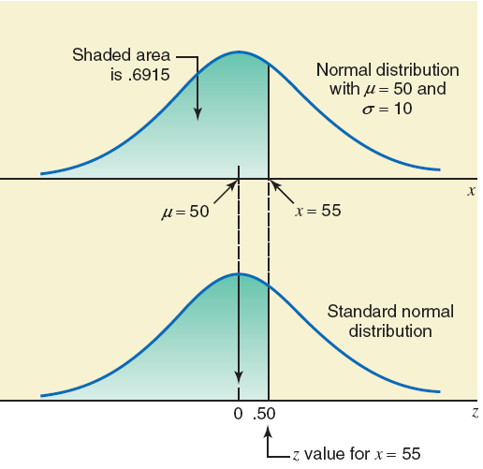
z value for x = 55.
Prem Mann, Introductory Statistics, 8/E Copyright © 2013 John Wiley & Sons. All rights reserved.

Slide 26
Example: Solution
(b) x = 35
P(x < 35) = P(z < -1.50) = .0668
Prem Mann, Introductory Statistics, 8/E Copyright © 2013 John Wiley & Sons. All rights reserved.

Slide 27
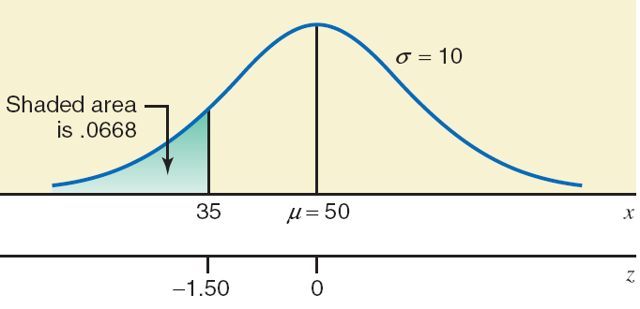
Figure: z value for x = 35.
Prem Mann, Introductory Statistics, 8/E Copyright © 2013 John Wiley & Sons. All rights reserved.

Slide 28
Example
Let x be a continuous random variable that is normally distributed with a mean of 25 and a standard deviation of 4. Find the area
(a) between x = 25 and x = 32
(b) between x = 18 and x = 34
Prem Mann, Introductory Statistics, 8/E Copyright © 2013 John Wiley & Sons. All rights reserved.

Slide 29
Example : Solution
(a) The z value for x = 25 is 0
The z value for x = 32 is
P (25 < x < 32) = P(0 < z < 1.75)
= .9599 - .5000 = .4599
Prem Mann, Introductory Statistics, 8/E Copyright © 2013 John Wiley & Sons. All rights reserved.

Slide 30
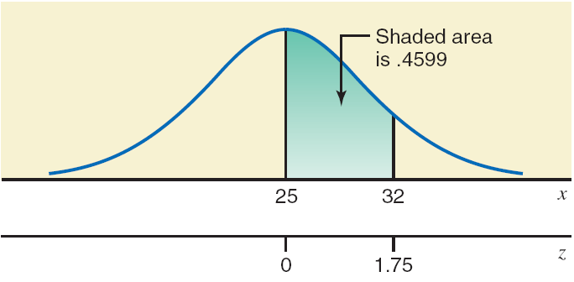
Area between x = 25 and x = 32.
Prem Mann, Introductory Statistics, 8/E Copyright © 2013 John Wiley & Sons. All rights reserved.

Slide 31
Example: Solution
(b) For x = 18:
For x = 34:
P (18 < x < 34) = P (-1.75 < z < 2.25)
= .9878 - .0401 = .9477
Prem Mann, Introductory Statistics, 8/E Copyright © 2013 John Wiley & Sons. All rights reserved.

Slide 32
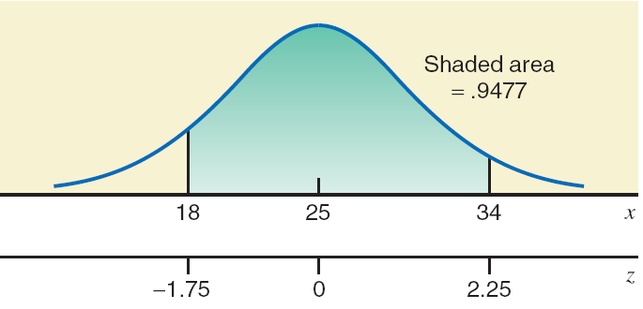
Area between x = 18 and x = 34.
Prem Mann, Introductory Statistics, 8/E Copyright © 2013 John Wiley & Sons. All rights reserved.

Slide 33
APPLICATIONS OF THE NORMAL DISTRIBUTION
Sections 6.1 and 6.2 discussed the normal distribution, how to convert a normal distribution to the standard normal distribution, and how to find areas under a normal distribution curve. This section presents examples that illustrate the applications of the normal distribution.
Prem Mann, Introductory Statistics, 8/E Copyright © 2013 John Wiley & Sons. All rights reserved.

Slide 34
Example
According to the Kaiser Family Foundation, U.S. workers who had employer-provided health insurance paid an average premium of $4129 for family coverage during 2011 (USA TODAY, October 10, 2011). Suppose that the premiums for family coverage paid this year by all such workers are normally distributed with a mean of $4129 and a standard deviation of $600. Find the probability that such premium paid this year by a randomly selected such worker is between $3331 and $4453.
Prem Mann, Introductory Statistics, 8/E Copyright © 2013 John Wiley & Sons. All rights reserved.

Slide 35

Example: Solution
For x = $3331:
$$z= \frac{3331 −4129}{600}=−1.33$$
For x = $4453:
$$z= \frac{4453 −4129}{600}=.54$$
P ($3331 < x < $4453) = P (-1.33 < z < .54)
= .7054 - .0918
= .6136 = 61.36%
Prem Mann, Introductory Statistics, 8/E Copyright © 2013 John Wiley & Sons. All rights reserved.

Slide 36
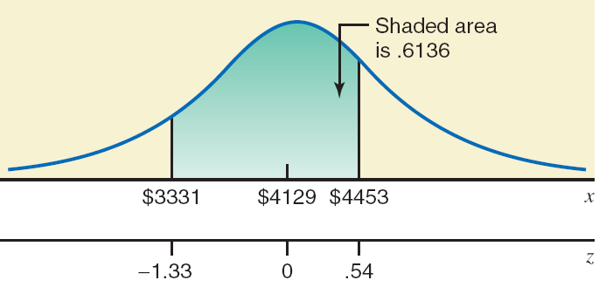
Area between x = $3331 and x = $4453.
Prem Mann, Introductory Statistics, 8/E Copyright © 2013 John Wiley & Sons. All rights reserved.

Slide 37
Example
A racing car is one of the many toys manufactured by Mack Corporation. The assembly times for this toy follow a normal distribution with a mean of 55 minutes and a standard deviation of 4 minutes. The company closes at 5 p.m. every day. If one worker starts to assemble a racing car at 4 p.m., what is the probability that she will finish this job before the company closes for the day?
Prem Mann, Introductory Statistics, 8/E Copyright © 2013 John Wiley & Sons. All rights reserved.

Slide 38
Example: Solution
For x = 60:
$z= \frac{60−55}{4}$ = 1.25
P(x ≤ 60) = P(z ≤ 1.25) = .8944
Thus, the probability is .8944 that this worker will finish assembling this racing car before the company closes for the day.
Prem Mann, Introductory Statistics, 8/E Copyright © 2013 John Wiley & Sons. All rights reserved.

Slide 39
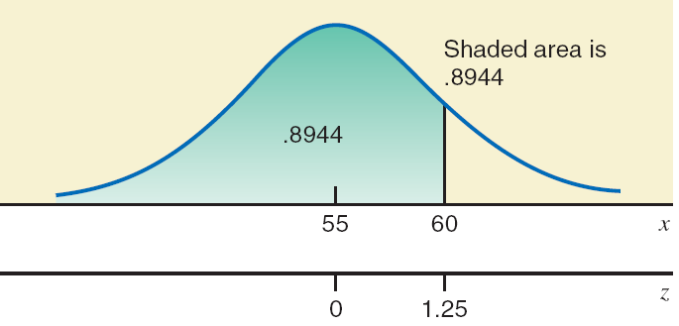
Area to the left of x = 60.
Prem Mann, Introductory Statistics, 8/E Copyright © 2013 John Wiley & Sons. All rights reserved.

Slide 40
DETERMINING THE z AND x VALUES WHEN AN AREA UNDER THE NORMAL DISTRIBUTION CURVE IS KNOWN
Now we learn how to find the corresponding value of z or x when an area under a normal distribution curve is known.
Prem Mann, Introductory Statistics, 8/E Copyright © 2013 John Wiley & Sons. All rights reserved.

Slide 41
Example
Find a point z such that the area under the standard normal curve to the left of z is .9251.
Prem Mann, Introductory Statistics, 8/E Copyright © 2013 John Wiley & Sons. All rights reserved.

Slide 42
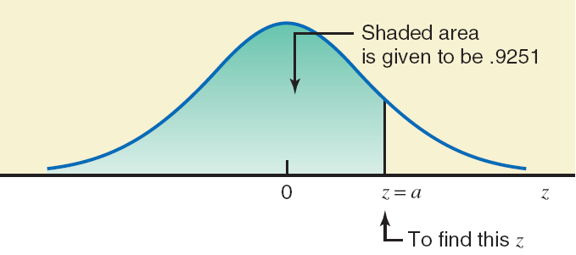
Finding the z value.
Prem Mann, Introductory Statistics, 8/E Copyright © 2013 John Wiley & Sons. All rights reserved.

Slide 43
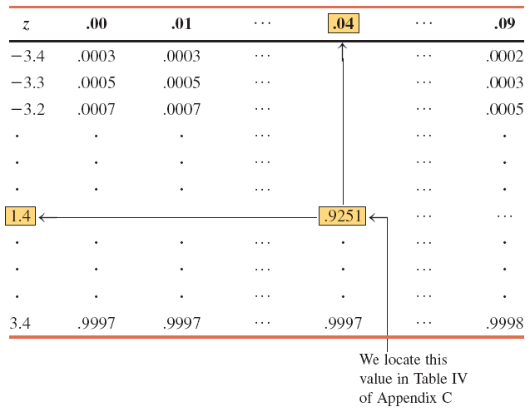
Finding the z Value When Area Is Known.
Prem Mann, Introductory Statistics, 8/E Copyright © 2013 John Wiley & Sons. All rights reserved.

Slide 44
Example
Find the value of z such that the area under the standard normal curve in the right tail is .0050.
Prem Mann, Introductory Statistics, 8/E Copyright © 2013 John Wiley & Sons. All rights reserved.

Slide 45
Example: Solution
Area to the left of z = 1.0 - .0050 = .9950
Look for .9950 in the body of the normal distribution table. Table VII does not contain .9950.
Find the value closest to .9950, which is either .9949 or .9951.
If we choose .9951, the z = 2.58.
If we choose .9949, the z = 2.57.
Prem Mann, Introductory Statistics, 8/E Copyright © 2013 John Wiley & Sons. All rights reserved.

Slide 46
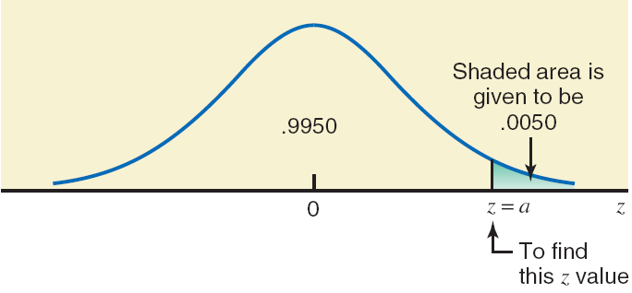
Finding the z value.
Prem Mann, Introductory Statistics, 8/E Copyright © 2013 John Wiley & Sons. All rights reserved.

Slide 47
THE NORMAL APPROXIMATION OF THE BINOMIAL DISTRIBUTION
1. The binomial distribution is applied to a discrete random variable.
2. Each repetition, called a trial, of a binomial experiment results in one of two possible outcomes, either a success or a failure.
3. The probabilities of the two (possible) outcomes remain the same for each repetition of the experiment.
4. The trials are independent.
Prem Mann, Introductory Statistics, 8/E Copyright © 2013 John Wiley & Sons. All rights reserved.

Slide 48
THE NORMAL APPROXIMATION OF THE BINOMIAL DISTRIBUTION
The binomial formula, which gives the probability of x successes in n trials, is
Prem Mann, Introductory Statistics, 8/E Copyright © 2013 John Wiley & Sons. All rights reserved.

Slide 49
THE NORMAL APPROXIMATION OF THE BINOMIAL DISTRIBUTION
Normal Distribution as an Approximation to Binomial Distribution
Usually, the normal distribution is used as an approximation to the binomial distribution when np and nq are both greater than 5 -- that is, when
np > 5 and nq > 5
Prem Mann, Introductory Statistics, 8/E Copyright © 2013 John Wiley & Sons. All rights reserved.

Slide 50
Example
According to an estimate, 50% of the people in the United States have at least one credit card. If a random sample of 30 persons is selected, what is the probability that 19 of them will have at least one credit card?
Prem Mann, Introductory Statistics, 8/E Copyright © 2013 John Wiley & Sons. All rights reserved.

Slide 51
Example: Solution
n = 30, p = .50, q = 1 – p = .50
x = 19, n – x = 30 – 19 = 11
From the binomial formula,
Prem Mann, Introductory Statistics, 8/E Copyright © 2013 John Wiley & Sons. All rights reserved.

Slide 52
Example: Solution
Let’s solve this problem using the normal distribution as an approximation to the binomial distribution.
np = 30(.50) = 15 > 5 and nq = 30(.50) = 15 > 5.
We can use the normal distribution as an approximation to solve this binomial problem.
Prem Mann, Introductory Statistics, 8/E Copyright © 2013 John Wiley & Sons. All rights reserved.

Slide 53
Example: Solution
Step 1. Compute μ and σ for the binomial distribution.
Step 2. Convert the discrete random variable into a continuous random variable (by making the correction for continuity).
Prem Mann, Introductory Statistics, 8/E Copyright © 2013 John Wiley & Sons. All rights reserved.

Slide 54
Continuity Correction Factor
Continuity Correction Factor
Definition
The addition of .5 and/or subtraction of .5 from the value(s) of x when the normal distribution is used as an approximation to the binomial distribution, where x is the number of successes in n trials, is called the continuity correction factor.
Prem Mann, Introductory Statistics, 8/E Copyright © 2013 John Wiley & Sons. All rights reserved.

Slide 55
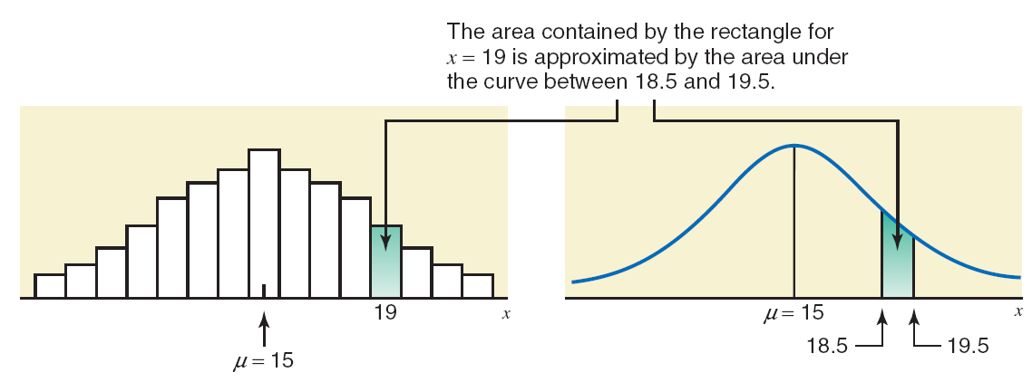
Figure
Prem Mann, Introductory Statistics, 8/E Copyright © 2013 John Wiley & Sons. All rights reserved.

Slide 56
Example: Solution
Step 3. Compute the required probability using the normal distribution.
For x = 18.5:
For x = 19.5:
P(18.5 ≤ x ≤ 19.5) = P(1.28 ≤ z ≤ 1.64)
= .9495 - .8997 = .0498
Prem Mann, Introductory Statistics, 8/E Copyright © 2013 John Wiley & Sons. All rights reserved.

Slide 57
Example: Solution
Thus, based on the normal approximation, the probability that 19 persons in a sample of 30 will have at least one credit card is approximately .0498.
Using the binomial formula, we obtain the exact probability .0509.
The error due to using the normal approximation is
.0509 - .0498 = .0011.
Prem Mann, Introductory Statistics, 8/E Copyright © 2013 John Wiley & Sons. All rights reserved.

Slide 58
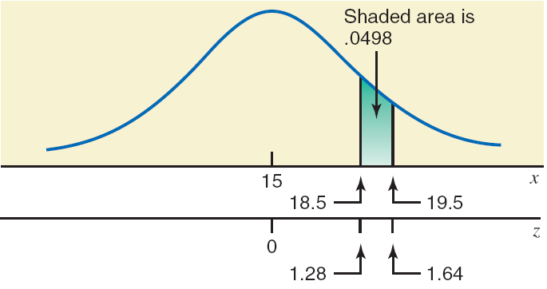
Figure: Area between x = 18.5 and x = 19.5.
Prem Mann, Introductory Statistics, 8/E Copyright © 2013 John Wiley & Sons. All rights reserved.

